Slide 1
Set Up, Implementation and Assessment of NKM Projects
School of Nuclear Knowledge Management
3-7 September 2012
Trieste, Italy
Presentation by Ed Boyles

Slide 2
Contents
Choice of NKM project
NKM project prerequisites
Implementation aspects
Key success factors
NKM programmes
Review of KM projects
Questions

Slide 3
Selecting NKM Projects
Reactive
Legislation
Customer/stakeholder requirements
Proactive
Benchmarking studies & competitor analysis
KM audit/maturity models
Business issues
Business improvement initiatives
Understand your DRIVERS!!!! & Ultimate BENEFITS
Notes:
Sometimes KM projects are ‘forced’ on organizations due to changes in legislation or from other external sources. These are reactive implementations
More usually the organization selects projects in a proactive way. This can be done using any of the above methods.
A third possibility is by ‘accident’. Some projects are undertaken where the initial intention is not KM related. Later, aspects of the project are classified KM retrospectively

Slide 4
There’s Room For Improvement
75% of IT projects are behind schedule
55% of all IT projects exceed their initial budget
37% failed to meet project requirements
And some, after huge investments of time and money, are simply never complete…….
Notes:
Source – Bull report for IT projects in UK (1998) and the Standish Group
No specific reference material for KM projects – but would suggest that the same failure rates apply

Slide 5
Project Prerequisites 1
Before the project begins:
Does the project align with organisational needs?
Is the purpose of the project clearly defined?
Are the benefits understood and well communicated?
Is there top level management support/commitment?
Is there a senior management sponsor?
Is a project manager assigned?
Are resources made available?
Is there sufficient ‘know how’ in the project team?
Notes:
Experience suggests that all these prerequisites should be in place for a successful project – these are the key success factors
Resources include both human resource, equipment/technology and financial
Project team ‘know – how’ means
an understanding of what KM is,
an understanding of the business issues, and
Credibility in the project technical area
A recent study by Young/Jordan suggest that top management support is the most important critical success factor for project success.
(see International Journal of Project Management , Vol 26, Issue 7)

Slide 6
Project Prerequisites 2
For sustained benefit, cultural issues need to be addressed:
Is knowledge sharing encouraged?
Is knowledge regarded as critical to individual and organizational success?
Is innovation encouraged?
Is self/organizational learning and development the norm?
If the above are not in place, the project may also need to be treated as part of a cultural change initiative
Notes:
Specific issues and advice related to KM and culture is the subject of a separate presentation

Slide 7


Project Scope
Other considerations:
Is there a need for a pilot project?
Is full implementation intended?
Local or Company wide?
Is a KM “programme” required – see later
Notes:
Sometimes a pilot is a good idea for testing complex or new ideas before full implementation. This helps to reduce implementation risk.
For large organizations involving several locations bullet 3 is important
A KM programme is a number of separate KM projects run in parallel

Slide 8
Typical Implementation Methodology (Including a Pilot Project Phase)
Phase 1 - Orientation
Familiarisation
Planning (inc. BP?)
Sponsorship
KM Drivers
~1Month
Collaboration &
Sharing
Phase 2 –Diagnosis
Benchmarking audit
Fit to organizational drivers,
Select pilot
Update plan
Working smarter
~3 to 6 Months
Making better decisions
Improved teamwork
Phase 3 –Pilot Implementation
Develop initial roadmap
Select tools/methodologies
Run project pilot
Lessons Learned from pilot
~ 3 to 6 Months
Increased learning
Embedding behaviours
Phase 4 Full implementation
Detailed plan
Roll out to other relevant areas
Communication
Presentations/Workshops
Stakeholder management
Time

Slide 9
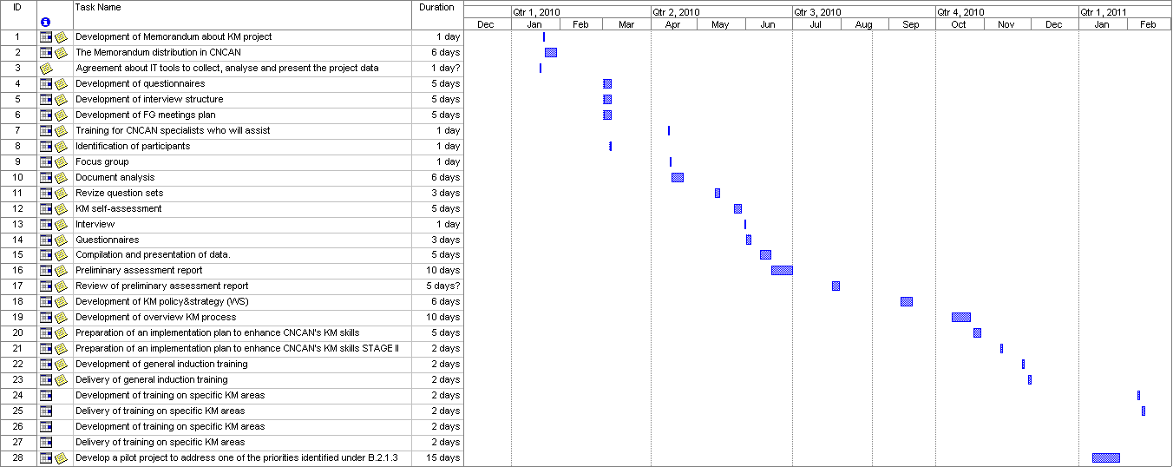
Case Study – Example Project

Slide 10
Example KM Project Structure
Phase Review Team or Steering Group
Project Sponsor
Senior Manager 1
Senior Manager 2
Senior Manager 3
Project Manager
Senior Manager 4
IT Development Team
Process Development Team
Implementation Team
Database Developer
Business process analyst
Business Team members
Web Developer
QA
support engineer
(various disciplines/skills)
Notes:
The IT development team and process development team typicaly come from the IT department & QA department respectively (but this need not be the case)
The Implementation team should come from the area(s) of the organization the project is to be implemented
A phase review team is an independent team of senior managers who scrutinize the project and ensure alignment with the business. They meet on a regular basis (perhaps 3 or 4 times during the duration of the project.

Slide 11
Full Implementation Strategy
Pilot outcome very important
Receptiveness of organisation to cultural change is very important
Options for full implementation:
  “Wide & thin” (limited functionality but across a large number of units)
  “Narrow and thick” (rich functionality but across one or two business units)
  “Hybrid” (a portfolio of initiatives)
Notes:
Hybrid option is essentially the same as a KM programme as defined later

Slide 12

KM Projects - Key Learning Points
KM methodologies and technologies work!
KM projects work best when they are focussed on real business issues
KM has many aspects and techniques. Selection of the best approach is very important
Much can be done without massive IT expenditure
Savings & benefits are very difficult to quantify - hidden by other initiatives ( e.g. restructuring, change in external conditions, new IT systems)
Ensure adequate resources are allocated
Beware of time overruns!

Slide 13
KM Programme Management
Resources
Cross Project
Links
Prioritisation
Performance
Management
A KM Project
A KM Project
A KM Project
A KM Project
A KM Project
A KM Project
A KM Project
A KM Project
Notes:
KM programme management is running a portfolio of KM projects –usually in parallel
All need prioritizing and need to be carefully monitored to ensure satisfactory performance (performance management)
Cross project links refer to the ability to understand how individual projects interact.

Slide 14
KM Programmes vs KM Projects
KM Project
More complex interface with the strategy
Has a defined start and finish date.
Focus is more on delivering immediate objectives
Simpler to set up and manage
Projects are ‘ring fenced’.
Usually have a narrow view
KM Programme
Contain many projects
Can be merged with management systems to drive continuous improvement
Have to address multiple initiatives
Culture & change are very important
Less well defined end date.
Focus is on delivering benefits and require action even when projects have ended.
Every programme must lead to business benefit
Notes:
Programme risk management starts before projects start and continues after the last project has closed (e.g. operations might not use the deliverables.)

Slide 15
The Value Path
KM Projects create deliverables. Programmes combine deliverables to create capabilities. The organisation utilizes the capabilities and gains BENEFITS
BENEFITS
Capabilities
Programmes
Deliverables
Project 1
Project 3
Project 2

Slide 16
Review of KM Projects
Project Reviews or ‘post-mortems’ are examinations at the end of a project to determine if:
the objectives of the project were achieved
the intended benefits were realised
lessons can be learned for future projects
Notes:
How do we ascertain if a KM project was a success?
KM projects are no different to any other project in this regard

Slide 17

Assessment Techniques
Objective checklist
Questionnaires to determine perception of project success
Pre and post project KPIs

Slide 18


Objective Checklist
We’ve achieved our objectives and…..
√
KM objective 1
√
KM objective 2
Completed on time and within budget so the project must be a success!!
√
KM objective 3
√
KM objective 4
√
KM objective 5
√
KM objective 6
Notes:
Were the project objectives established at the start of the project realised?
Were they achieved within time & budget?
One measure of success.
If only some of the objectives were achieved then the project was a “partial” success.

Slide 19

Questionnaires or Critiques
In my opinion this project was a great success!!
KM Project Questionnaire
Notes:
Asking participants, in the form of a questionnaire, is a valuable method of receiving feedback on the success of the project.
Although only a qualitative measure, it is very important especially for the success of future initiatives.
Make sure results of successes are well communicated.

Slide 20

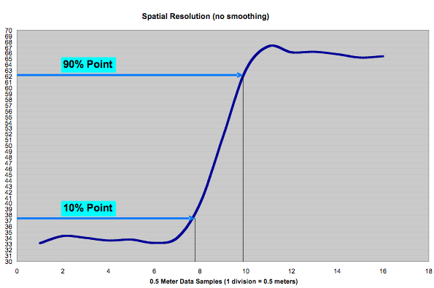

Using KPIs
Key Performance Indicator 1
Performance
What a great project!!
KM Project starts
Time
Notes:
KPIs must be established before the project begins.
The choice of KPIs depend on the type of project undertaken and should relate to the benefits sought.

Slide 21
Summary
There are key success factors to consider at the outset when selecting and planning NKM projects
Certain pre-requisites must be in place to ensure success
Managing NKM projects is very similar to managing ‘change management projects’
Portfolio management or programme management is used to run multiple KM initiatives
Different techniques can be used to determine success of NKM projects

Slide 22
Thank You For Your Attention
Questions ?

