Slide 1

Communities of practice

Slide 2

Knowledge Management at Sellafield
Having the right knowledge in the right place at the right time
Having an actionable plan to make this happen.

Slide 3
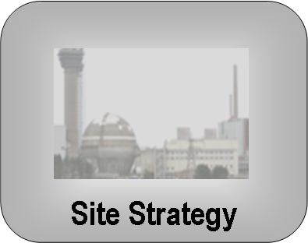

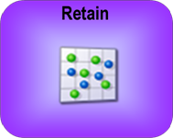
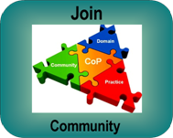
Knowledge Management at Sellafield - KM priorities
Define the problem
  Organisational context, mission and strategy
Develop an actionable plan
  Identify key knowledge needs for the mission
Implement the plan using focused KM tools
  Knowledge Retention and Transfer (KRT)
  Communities of practice
  Etc.

Slide 4
Organisational dimensions underpinning KM paradigms
Organisational design & control – Centralised v devolved
Centralised control Federated Decentralised
Minimum compliance Business case Maximum opportunity
Expert knows best Communities Wisdom of the crowd
Motivation and investment – Benefits v costs
Where the knowledge resides – Concentrated v diffused

Slide 5



































Operational framework
Central coordination
CKO
Health checks
Teams
Guidance
Support & guidance
Central governance
Decisions
Governance Committee
Resources
Prioritised plan
Tools
Training
Common and locally tailored business applications
Leadership
Leadership
IT
Single search
Expertise finder
Collaborate
Mobilise
Expectations &
competences
Explicit knowledge
library
Innovate
Processes & systems
Structure
Apply & Learn
Knowledge area
coordinator
Community
Encouragement
LL library
Learn before
during and after
Capture & Validate
Good practice library
Capture
Validation
Proficiency

Slide 6
Project
Tranches
Project
Activities
Project
Outputs
Business
Benefits
Strategic
Objectives
KM skills and roles
Standardised knowledge processes
Leadership & Motivation
Mistakes not repeated
Meet requirements
Knowledge sharing and validation
Knowledge is captured and retained
Prioritise
Good practises reused
Reduce hazard
Knowledge content and storage
Knowledge is found and reused
Communities
Reduced risk of knowledge loss
Knowledge retention
Communities
Reduce lifetime cost - Add value
Knowledge retention
Better decision making
Knowledge at risk and priorities
Knowledge is shared
Increase efficiency
Learning
& Innovation
Faster organisational learning
Single search and Expertise finder
Enabling knowledge technologies
Improve nuclear & conventional safety
IT tools & Infrastructure
Improved capability, performance & efficiency
Collaboration platform
Competent and motivated people

Slide 7
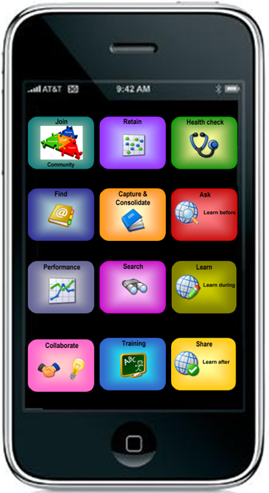
Knowledge Management@Sellafield

Slide 8
Communities of Practice (CoPs)

Slide 9
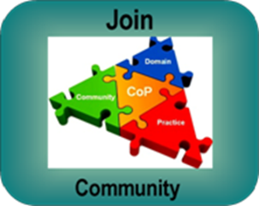
Outline
  What are Communities?
  Your own Communities
  How do you differentiate Communities from other types of groups?
  Community Roles and Participation
  The Value of Communities
  The Lifecycle of Communities
  How they work
  Tools
  Action Plans
Notes:
what they are
their history
how they differ from other types of groups or networks
who’s involved and what they do
their purpose and value
managing the lifecycle of a community
how they work and the tools they use
and if there’s time we’ll ask you to complete an action plan to improve the effectiveness of your own communities
Does everyone understand the programme and is there anything they’d like to add?

Slide 10
Community:
members engage in joint activities to develop and share information, building relationships that enable them to learn from each other.
Domain:
not merely a club or a network of people the CoPs’ identity is defined by a shared domain of interest.
Practice:
Members develop a shared repertoire of resources, experiences, stories, tools and solutions to recurring problems - in short a shared practice.

Slide 11

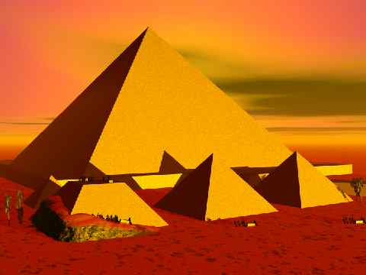
Some of the oldest communities
Notes:
Definitions
What do you all about communities let’s start by collecting some of your definitions of what communities are
Facilitator captures on flip chart
Now what about the origins of communities ask for feedback and try to get them to agree on a date
Facilitator encourage attendees Shout out
Communities have existed for thousands of years
Caveman sitting around the fire and sharing his hunting experiences
Work force responsible for constructing the great pyramids at Giza;
Teams for each discipline, lived , ate and socialised together in designated villages
Sharing knowledge and experience sometimes from generation to generation.
An estimated 20,000 to 30,000 workers built the Pyramids at Giza over a period of 80 years.

Slide 12
Definition of a Community
Origins in theoretical studies by Jean Lave & Etienne Wenger
A network of professionals helping each other
A professional group with expertise, and a shared passion for a specific subject
Not bound to organisational departments; not specifically focused on a specified task or activity
Can support innovation in multi-organisational settings
Takes care of knowledge sharing within the network
Has a clear value-proposition for its members:
    Time saving - work is ready earlier
    Enables to deliver better quality
    Recognition
Can be self-organising
Can be sponsored
Notes:
Expert definitions
Best known is the work of Jean Lave and Etienne Wenger
Coined the term communities while studying the learning model of apprenticeship
This is the definition CIBIT uses. The emphasis on professionals is important because the characteristics and success factors of ‘work related’ communities differs a lot from the so called hobby of passion communities. Issues like ‘trust’, ‘what is in it for me’ and the balance between individual goals and business goals play an important role in ‘work related communities’.
Some organizations don’t use the term communities. They (still) use terms like Special Interest Group, Virtual Organization, Network or Virtual Teams. Some of these terms mean the same. But sometimes these organizations refer to project teams (who use ICT for work and communication).
See next slide for essential differences between communities and teams.

Slide 13
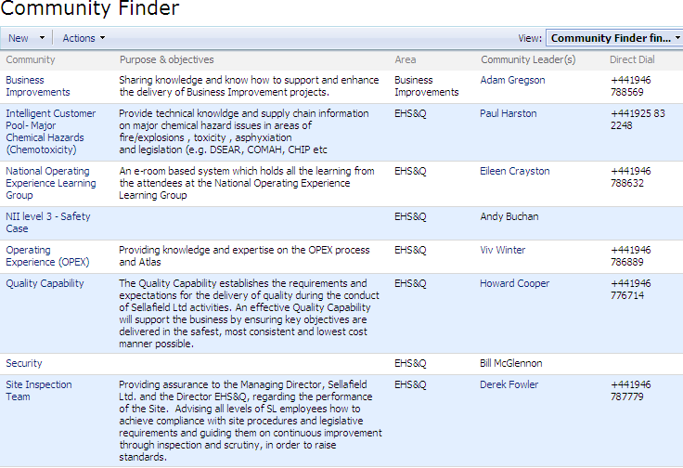
We all belong to communities
Notes:
What communities do you participate in?
Here are some examples of communities in society.
The objective is to make us realise in how many communities we participate in our social life.
Communities are something natural now turned into organisational structures.
This is a nice case! But, make sure that you do explain what the difference between just a regular community and a CoP!
A CoP is a type of a church-Community. The difference lies in the world 'practice'. E.g. A club of university friends does not have a practice it evolves around - this would therefore just be a community. A hockey team would have a practice, so you could call it a CoP. However, this practice is not aimed at something that is relevant to the company, therefore it is also not the type of CoP we refer to in this course.
Remember:
Community: A body of persons with common (professional) interests scattered through a larger society
Practice: A systematic exercise for proficiency

Slide 14
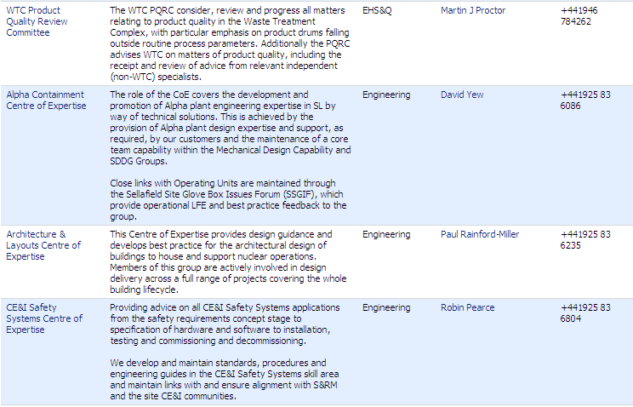
We all belong to communities
Notes:
What communities do you participate in?
Here are some examples of communities in society.
The objective is to make us realise in how many communities we participate in our social life.
Communities are something natural now turned into organisational structures.
This is a nice case! But, make sure that you do explain what the difference between just a regular community and a CoP!
A CoP is a type of a church-Community. The difference lies in the world 'practice'. E.g. A club of university friends does not have a practice it evolves around - this would therefore just be a community. A hockey team would have a practice, so you could call it a CoP. However, this practice is not aimed at something that is relevant to the company, therefore it is also not the type of CoP we refer to in this course.
Remember:
Community: A body of persons with common (professional) interests scattered through a larger society
Practice: A systematic exercise for proficiency

Slide 15
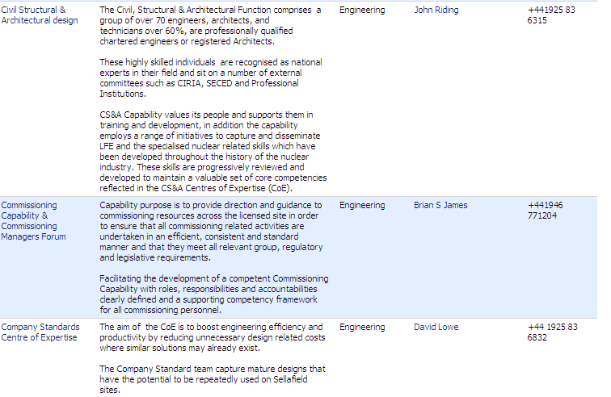
We all belong to communities
Notes:
What communities do you participate in?
Here are some examples of communities in society.
The objective is to make us realise in how many communities we participate in our social life.
Communities are something natural now turned into organisational structures.
This is a nice case! But, make sure that you do explain what the difference between just a regular community and a CoP!
A CoP is a type of a church-Community. The difference lies in the world 'practice'. E.g. A club of university friends does not have a practice it evolves around - this would therefore just be a community. A hockey team would have a practice, so you could call it a CoP. However, this practice is not aimed at something that is relevant to the company, therefore it is also not the type of CoP we refer to in this course.
Remember:
Community: A body of persons with common (professional) interests scattered through a larger society
Practice: A systematic exercise for proficiency

Slide 16
We all belong to communities
Individually:
How many can you identify?
  In your own organisation?
  External Communities?
As a GROUP:
  Discuss their common characteristics
Notes:
What communities do you participate in?
Here are some examples of communities in society.
The objective is to make us realise in how many communities we participate in our social life.
Communities are something natural now turned into organisational structures.
This is a nice case! But, make sure that you do explain what the difference between just a regular community and a CoP!
A CoP is a type of a church-Community. The difference lies in the world 'practice'. E.g. A club of university friends does not have a practice it evolves around - this would therefore just be a community. A hockey team would have a practice, so you could call it a CoP. However, this practice is not aimed at something that is relevant to the company, therefore it is also not the type of CoP we refer to in this course.
Remember:
Community: A body of persons with common (professional) interests scattered through a larger society
Practice: A systematic exercise for proficiency

Slide 17

We all belong to communities
Bridge Club
Business Unit
Your Church
University Friends
Soccer club
Your Family
Yoga Class
Your Orchestra
Friends from your last job
Notes:
What communities do you participate in?
Here are some examples of communities in society.
The objective is to make us realise in how many communities we participate in our social life.
Communities are something natural now turned into organisational structures.
This is a nice case! But, make sure that you do explain what the difference between just a regular community and a CoP!
A CoP is a type of a church-Community. The difference lies in the world 'practice'. E.g. A club of university friends does not have a practice it evolves around - this would therefore just be a community. A hockey team would have a practice, so you could call it a CoP. However, this practice is not aimed at something that is relevant to the company, therefore it is also not the type of CoP we refer to in this course.
Remember:
Community: A body of persons with common (professional) interests scattered through a larger society
Practice: A systematic exercise for proficiency

Slide 18
Identify your own communities
Each person INDIVIDUALLY :
  Think of all the non-work communities you have been part of at some time or other
As a GROUP:
  ……….
Notes:
Once complete ask them to stick post its on the wall and group together, encourage discussion around the category selection process.

Slide 19
What does it take to keep YOUR community going?
Why do you belong to your community?
  What did you enjoy about being a member?
  What made them work?
  Think about the things that it needs to keep going
Think about ‘Hard’ and ‘Soft’ things and put them onto post-it notes, one per post-it, and transfer them onto the ‘Community Worksheet’
What is THE reason why you are (still) part of the community
  Write it on a different coloured post it
  Transfer it onto the ‘Member?’ box
What is THE reason why you are no longer part of the community
  Write it on a different coloured post it
  Transfer it onto the ‘Ex Member?’ box
Notes:
The objective is to make them realise what keeps the community together and what are the issues that make a community worthwhile.
Examples of hard things:
Meeting room
Money
A car to get there
Examples of soft things:
It has to be fun
My wife has to let me go
There can't be any tension
Everybody has to be motivated
We have common interests

Slide 20
The value of Communities to the Organisation
  Access to expertise
  They can start new lines of business
  They solve problems quickly
  Enhance quality of decision making
  They transfer best practice, e.g. Chrysler
  They develop professional skills, e.g. neurosurgeons
  They develop new approaches and tools
  They help companies recruit and retain talent

Slide 21

The value of Communities to this Organisation
‘Communities are the cornerstone of improved knowledge and information management arrangements across the site.
Paul Foster: (Chief Knowledge Officer)

Slide 22
The value of Communities to the Individual
HM
  Improve experience of work, more meaningful participation
  Foster professional development and enhanced professional reputation
  Forum for expanding skills and expertise
  Network for keeping abreast of a field
  Increase marketability and employability
  Strong sense of professional identity and sense of belonging

Slide 23
Communities are and are not….
Group type | The purpose? | Who belongs? | What holds it together? | How long does it last?
Community of practice | Develop members’ capabilities; Build and exchange knowledge | Members who select themselves | Passion, commitment, identification with group’s expertise | As long as there is interest in maintaining the group
Formal work group | Deliver a product | Everyone who reports to the group’s manager | Job requirements and common goals | Until the next reorganisation
Project team | Accomplish a specified task | Employees assigned by senior management | The project’s milestones and goals | Until the project has been completed
Informal network | Collect and pass on business information | Friends and business acquaintance | Mutual needs | As long as people have a reason to connect
Wenger and Snyder, ‘Communities of Practice: The Organizational Frontier’. HBR Jan/Feb 2000

Slide 24
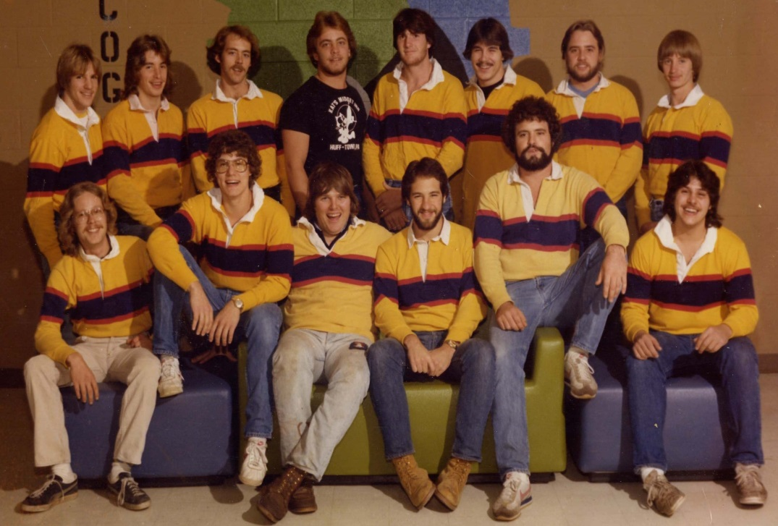
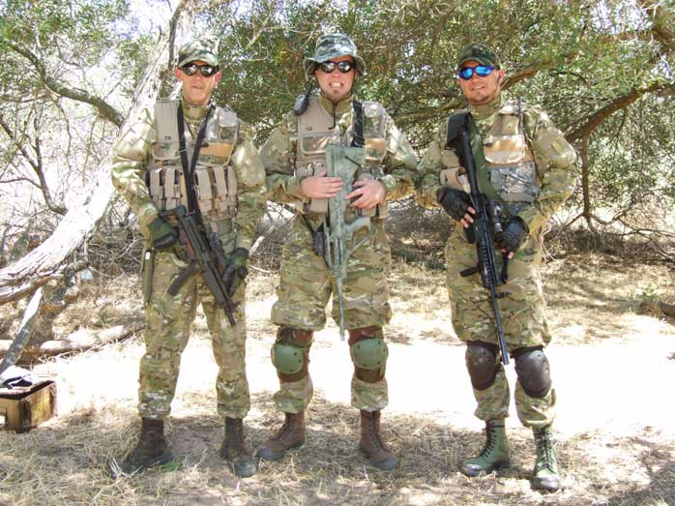
What do communities look like?
Notes:
Next we’ll look at the different roles within the community.

Slide 25
Communities of Practice
Creating opportunities to
Ask, Learn & Share
Notes:
Expert definitions
Best known is the work of Jean Lave and Etienne Wenger
Coined the term communities while studying the learning model of apprenticeship
This is the definition CIBIT uses. The emphasis on professionals is important because the characteristics and success factors of ‘work related’ communities differs a lot from the so called hobby of passion communities. Issues like ‘trust’, ‘what is in it for me’ and the balance between individual goals and business goals play an important role in ‘work related communities’.
Some organizations don’t use the term communities. They (still) use terms like Special Interest Group, Virtual Organization, Network or Virtual Teams. Some of these terms mean the same. But sometimes these organizations refer to project teams (who use ICT for work and communication).
See next slide for essential differences between communities and teams.

Slide 26
Community focus
helping communities
learning communities
best practice communities
knowledge stewarding
innovation communities
provide a forum for members to help each other solve day to day problems
provide an environment for members to support learning, ie from each other’s practices and experiences
developing and sharing best practices, guidelines and procedures for use
organising, managing and stewarding a body of knowledge from which members can draw
Multi-departmental and organisational participation events increases the overall body of knowledge enabling members to create, develop & share new ideas & practices

Slide 27
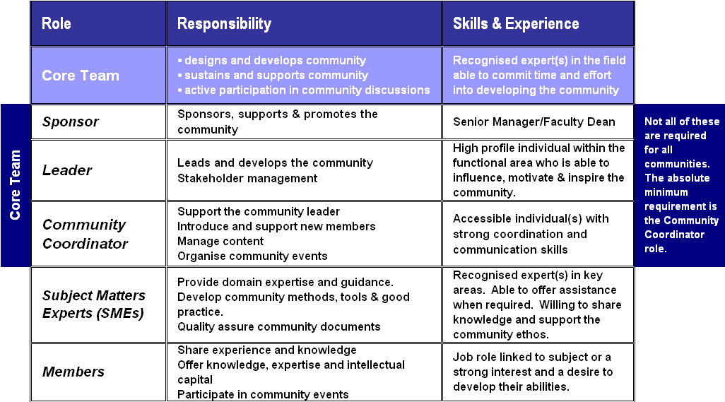
Different Community Roles
Notes:
Different Community Roles
The success of CoPs is determined by the evolution of the roles within the community and matching personalities to roles so behavioural competences are a major consideration in the selection of the team
Ask them to identify the different roles in their own communities
Think about your own communities that worked well
Were the roles clearly defined
Were the personalities of the role holder well matched to the post?

Slide 28
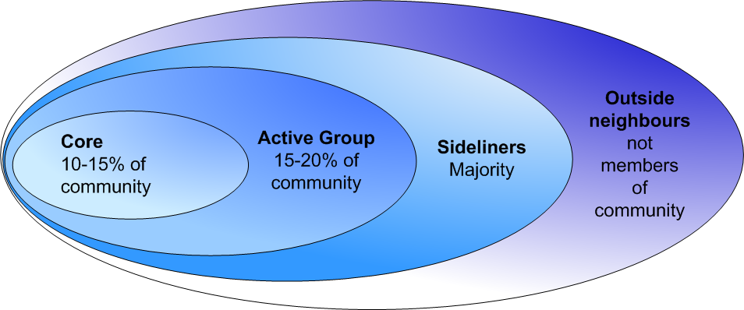
Participation in Communities
Notes:
Participation in Communities
Communities continue to change and evolve as does the participation of members which changes to meet their needs.
The next slide gives more clearly illustrates the participation of each member group in the community.

Slide 29
Participation in Communities – a school
Notes:
Core team represented by the board of Governors.
‘Active Group’ is comprised of parents
Majority of membership is taken up by the pupils.
Local community takes up the rest of the membership
Participation may change due to having children join the school or their interest in school based community events such as entertainment or evening classes.
Regular reviews by the members will ensure that the community continues share a common purpose and meets the needs of its members.

Slide 30
Lifecycle of networks
Level of activity
Kick off
Critical Phase
Critical Phase
Start
Experiment
Growth
Mature
Transition
Time
Notes:
This was shown earlier, in the presentation what’s a CoP. I just want to recap the phases a CoP goes through, and the changes in level of activity that come with those phases.

Slide 31
The Starting Phase 1/4
The situation:
Search for themes and networks
Members explore added value
The challenge:
Creating awareness & momentum
Instruments:
Knowledge markets and start workshops
Tips:
Segment and delineate target group
Pragmatically partnering and selecting themes

Slide 32
The Starting Phase 1/4
Identify potential online support options:
  software platforms/tools within your IT infrastructure, possibly allowing access by members that are on the other side of the firewall.
Identify communication mechanisms and key messages:
  community launch, key messages and ways to convey them (e-mail? An Intranet or webpage? An article in a newsletter?).
Identify and approach extended membership:
  potential members-to-be need to be made aware of the community willingness to participate need to be gauged.
Organise kick off:.
  build relationships, to refine the initial knowledge agenda, to establish ways of working and to start solving problems

Slide 33
The Starting Phase 2/4
We want to ............
  Share knowledge, best practices and lessons learned to improve systems and processes
  Develop tools, methods and frameworks
  Solve problems
  Improve motivation for professionals
  Improve knowledge creation and sharing, & improve input for company technical strategy, business relevance
  Mentor and coach each other
  Work together to identify joint flexible problem solving, reduce parallel work and avoid repetition of errors
..........................because ...................... (organisational goals)
Notes:
Dit werkt het beste als je je richt op 1 van de bovenste 4 doelen.
Vraag: Wat is het belangrijkste doel van jullie kenniskring?

Slide 34
The Starting Phase 3/4
Set direction – achieving the goals of the community
What do YOU need to have, in order to meet your own community’s objectives?
  Use the wording “we want to …. because....”
E.g. “we want to develop a community of CoP leaders because we want to share each other’s knowledge, experience and best practice to achieve Six4Five because we want to ensure we maximise the bonuses we receive”

Slide 35
The Starting Phase 4/4
Creating the Community Charter
Determine the vision and mission
Agree purpose and objectives
Agree the scope and community goals
Establish the High-Level requirements that the community’s product, service, or result must meet in order for the community objectives to be satisfied
Agree deliverables
Community Participation
– Roles & Responsibilities
– Matching Personalities to Roles
Align individual and organisational benefits
Agree membership rules
Review charter and launch the Community of Practice

Slide 36
Getting started – the Knowledge Market

Slide 37
The Experimentation Phase
The situation:
Connecting themes with people
Trying out hit & run activities
Find your own way of working
The challenge:
Create added value content
Create added value in personal contacts
Working together
Instruments:
Dossiers, X-sessions, workshops, Knowledge Markets
Tips:
Clear approach and house style
(Regional) meetings
Address specific themes with sufficient depth

Slide 38
The Growth Phase
The situation:
Identifying new issues, information sources & knowledge suppliers and issues.
Absorbing new target groups and implementing new ways of working
The Challenge:
Knowledge validation
Segmentation of supply (on website and at meetings)
Instruments:
‘In-depth’ workshops and Focus groups
Virtual discussions and tight content management
Tips:
Pay attention to practice leaders separately
Activate members and suppliers

Slide 39
The Mature Phase
The situation:
Members will do more and more by themselves
Re-align goals with organisation
The challenge:
Letting go
Finding new core team members
Keep it exciting
Instruments:
Similar to growth phase
Tips:
Ensure stable rhythm of activities with recognisable ‘face’ formula
Renew relations with (local) knowledge suppliers

Slide 40
Tools & when to apply
 | Start | Experiment | Growth | Mature
Start workshop
Knowledge Market
Reusability workshop
Expert meeting
Best Practice transfer
Sharing day
Virtual discussion

Slide 41
Matching tools to community focus
helping communities
learning communities
best practice communities
knowledge stewarding
innovation communities
provide a forum for members to help each other solve day to day problems
provide an environment for members to support learning, ie from each other’s practices and experiences
developing and sharing best practices, guidelines and procedures for use
organising, managing and stewarding a body of knowledge from which members can draw
Multi-departmental and organisational participation events increases the overall body of knowledge enabling members to create, develop & share new ideas & practices
The focus or types of communities is typically a mix of all of these elements and is likely change over time

Slide 42
Virtual Tools for Collaboration
Notes:
Show home page of KM Sharepoint wiki

Slide 43
Knowledge Hub
The NDA Knowledge Hub is a single point of knowledge for the completion of the NDA mission.
The Hub :
  Enable easy access to subject matter experts;
  Support peer-to-peer collaboration;
  Enable day-to-day support to communities of practice;
  Enable virtual working groups;
  Enable Estate-wide sharing in projects;
  Host the NDA knowledge Risk Programme;
  Host libraries of lessons learned, good practices and expertise.

Slide 44
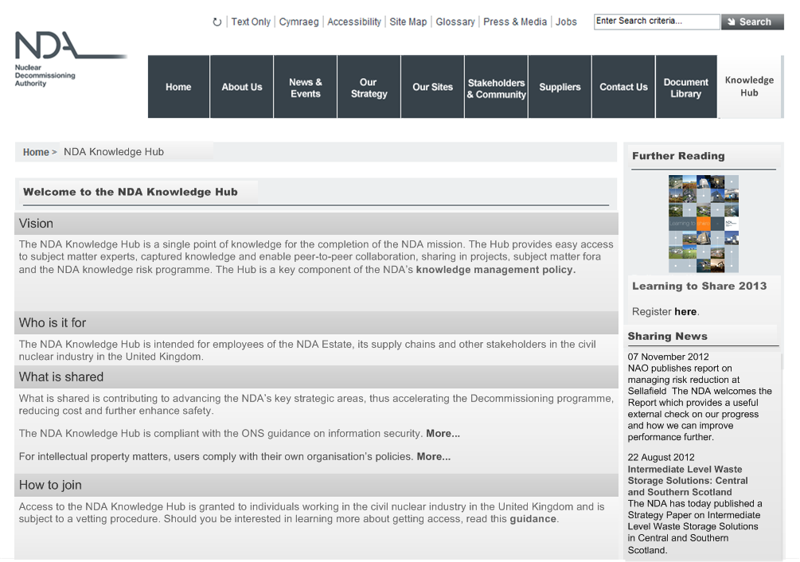
Public page

Slide 45
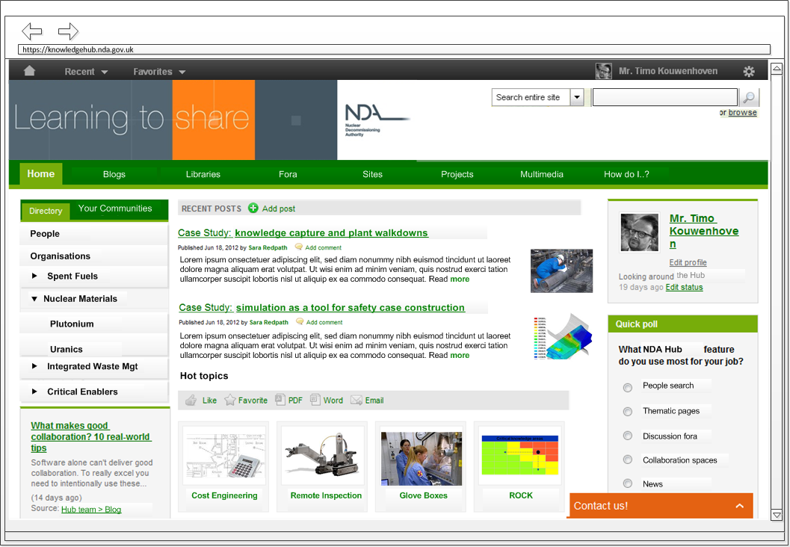
Personal homepage

Slide 46
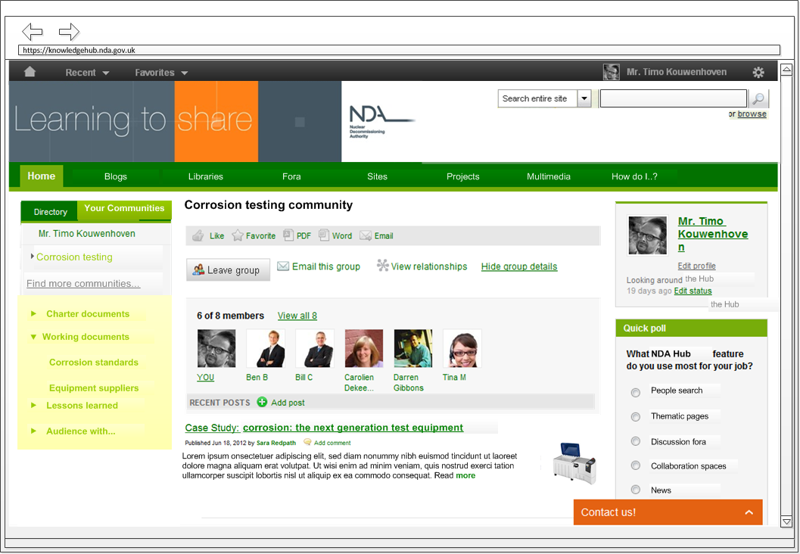
Sample community page

Slide 47
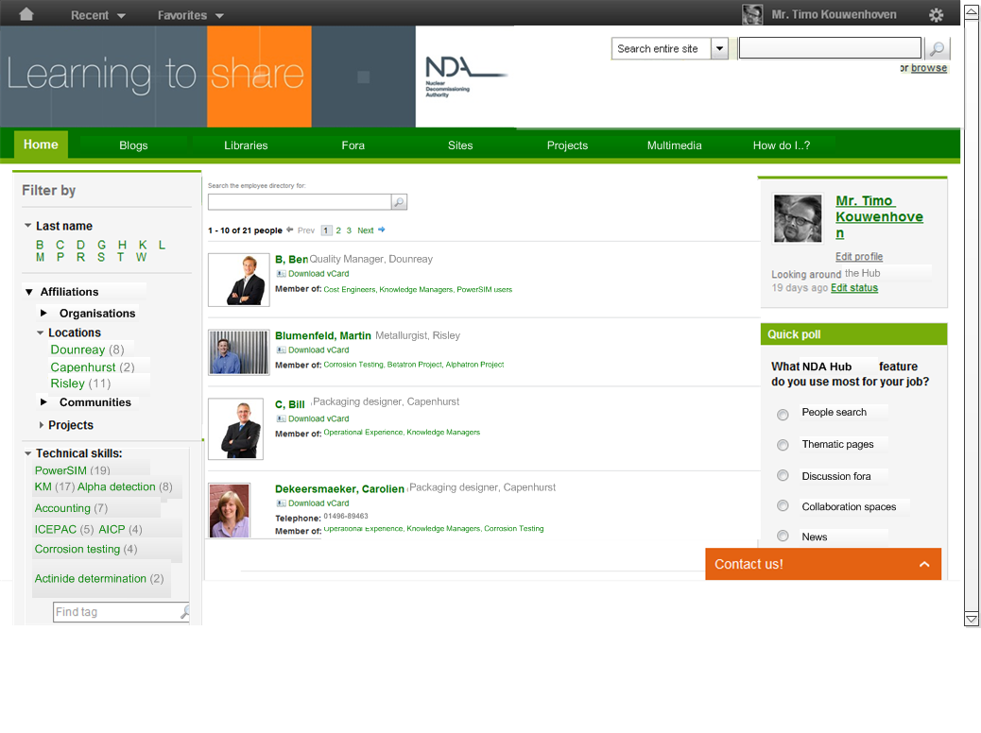
People finder

Slide 48
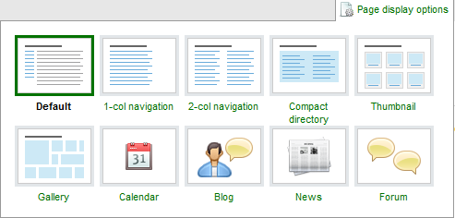
Flexible, user-controlled lay-out

Slide 49
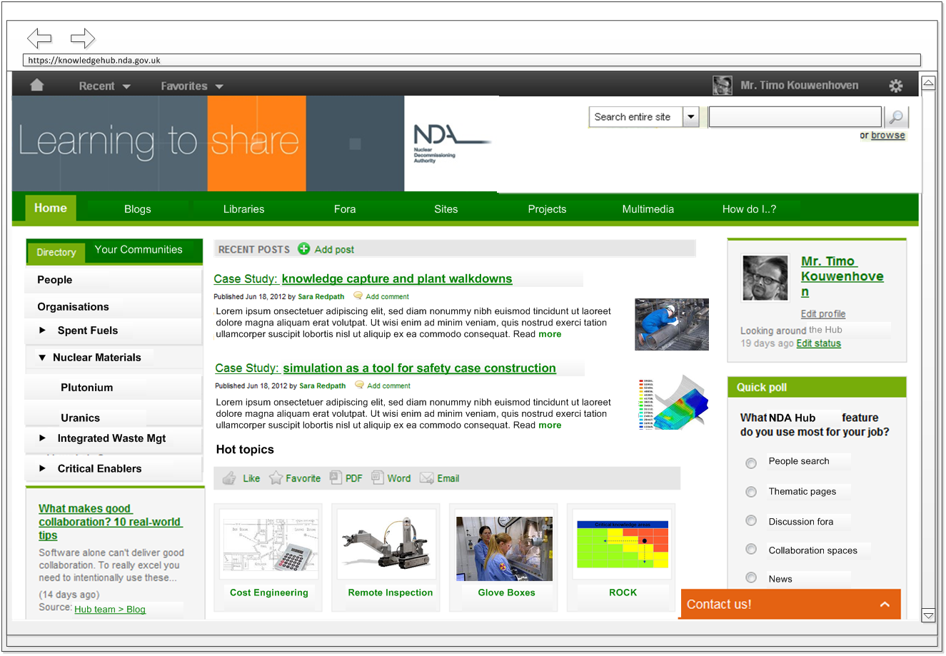
Knowledge hub

Slide 50
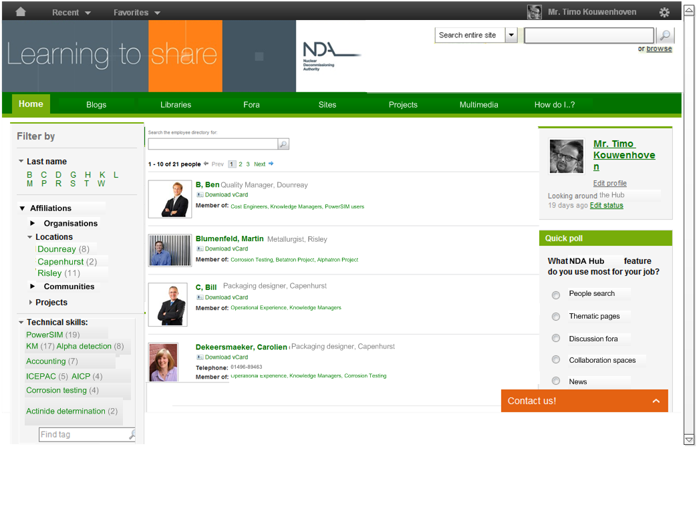

Slide 51
Conclusions
Communities of practice have always been an effective way of maintaining knowledge and developing best practice
Some organisations find them very useful
Culturally dependent

