Slide 1


Taxonomy Development
A. Kosilov
School of Nuclear Knowledge Management
3-7 September 2012, Trieste, Italy

Slide 2
Agenda
What is a taxonomy?
Major Taxonomy Development Tasks
Seven stages to creating a taxonomy
Infrastructure Model of Taxonomy Development
Conclusion

Slide 3
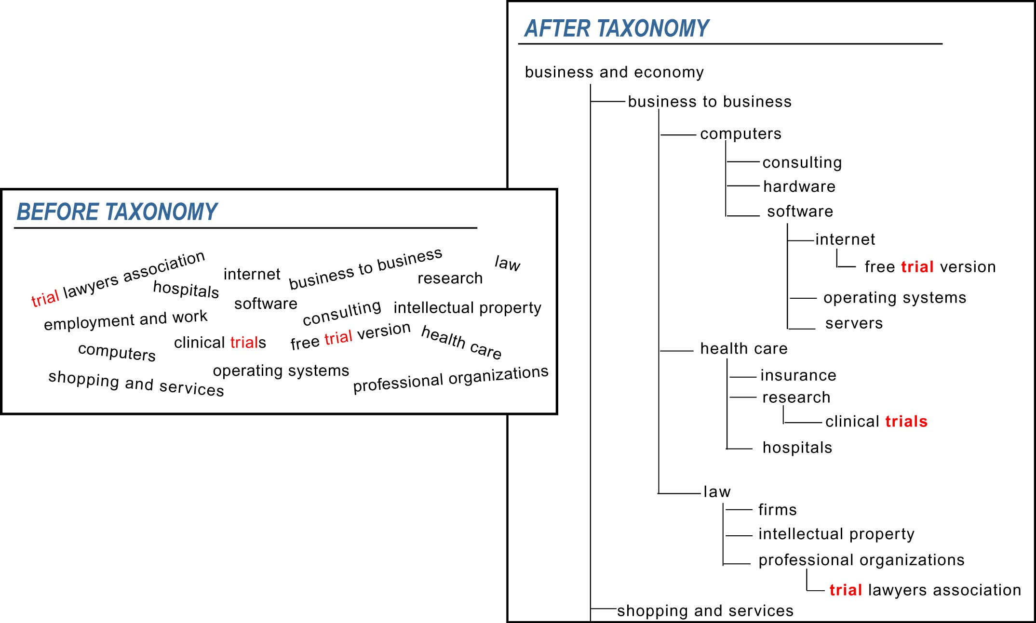

Slide 4
What is a Taxonomy?
IAEA: taxonomy -
A hierarchical structure in which a body of information or knowledge is categorized, allowing an understanding of how that body of knowledge can be broken down into parts and how its various parts relate to each other. Taxonomies are used to organize information in systems, thereby helping users to find it.
Taxonomies represent a predefined organizational structure that can cover a range of subjects from general industries or fields of study to the relevant words and terms unique to the business. They are usually arranged hierarchically, reflect general to more specific relationships and show correlations between subject areas.

Slide 5
Major Taxonomy Development Tasks
Taxonomy Scoping
Taxonomy Building
Taxonomy Evaluation

Slide 6
Seven stages to creating a taxonomy
Determine taxonomy requirements
Identify concepts - where is the content and what do the users think?
Develop draft taxonomy
Review with users and SMEs
Refine taxonomy
Apply taxonomy to content
Manage and maintain taxonomy

Slide 7
1. Determine taxonomy requirements
Questions to answer:
What is the problem the user is trying to solve?
What content needs to be organized?
How will the taxonomy be used?
What is the scope and purpose of the taxonomy?

Slide 8
Determine taxonomy requirements
POSSIBLE TASKS
Determine the sponsor and the stakeholders.
Assign a team leader. Recruit team members if necessary.
Determine the target audience.
Determine the users’ information needs. Interview users about their information needs/uses/problems.
Define scope and purpose of the taxonomy.
Determine objectives to be accomplished.
Determine if funding (budget) is available for the taxonomy.
Find out what technology the user plans on using (if any) and what constraints the technology might have on the taxonomy.
Develop a communication plan to keep stakeholders informed.
Create the schedule.
POSSIBLE OUTOUTS
Business case document.
Scope statement.
Description of the expectations for the project.
Project plan with tasks and schedule.
Description of the technology that will be used.
Buy-in from sponsors and stakeholders.
List of interview questions.
Transcript of the interviews.
Summary of the users’ information needs.

Slide 9
2. Identify concepts
Part A: Discover where and what the content is
Questions to answer:
What content will the taxonomy be used to organize?
Where is the existing content located?
How is the content structured?
Who is responsible for the content?
What is the value of the content?
Part C. Conduct user interviews
Questions to answer:
What concepts and information do users search/browse for most often?
How do users search for information?
Part B. Perform a content inventory
Questions to answer:
What subjects/topics are covered by the content?
What format is the content in?
What types of content are there?
What are the metadata (if any) for the content?

Slide 10
3. Develop draft taxonomy
Possible tasks:
Establish guidelines and standards for format of terms and construction of relationships.
Examine existing controlled vocabularies to determine if they could be used as is or modified to meet the user’s needs.
Develop upper levels of the taxonomy structure.
Use candidate terms and other resources to build depth into the taxonomy.(Other resources can include existing thesauri, dictionaries, handbooks, file directory structures, web site categories, etc.)
Reconcile language and terminology issues.
Develop hierarchical relationships between terms.
Develop cross-references between synonyms.
Develop scope notes to define the terms.
Build enough depth into the taxonomy so that the overall structure can be validated.
Possible outputs:
A draft taxonomy ready for review.
Guidelines and standards for constructing terms and relationships. (Example: ANSI Z39.19, local guidelines)
Notes:
ANSI/NISO Z39.19 - Guidelines for the Construction, Format, and Management of Monolingual Controlled Vocabularies

Slide 11
4. Review with users and SMEs
Questions to answer:
Does the structure make sense to the users?
Are the major concepts included in the taxonomy?
Does the taxonomy go too deep in any place?
Are the users and subject matter experts able to validate the taxonomy?

Slide 12
Review with users and SMEs
Possible tasks:
Possible outputs:
Ask the users and subject matter experts to examine the draft taxonomy and suggest changes.
Discuss and determine appropriateness of requested changes.
Perform usability studies of the taxonomy.
List of user comments and suggested changes.
Record of suggested changes to the taxonomy, including any decisions about and reasons for changes to the overall taxonomy design.
Results of the usability studies.

Slide 13
5. Refine taxonomy
Possible tasks:
Review user and subject matter expert feedback.
Incorporate agreed-to changes.
Incorporate changes based on analysis of results of the usability study.
Continue to build depth into the taxonomy. How deep the taxonomy should be is dependent on user feedback and whether the taxonomy nodes retrieve any content.
Solicit input from users and subject matter experts during this process.
Document all changes and decisions regarding the taxonomy.
Establish evaluation and testing criteria for the taxonomy.
Possible outputs:
Refined taxonomy.
Documented history of changes and decisions.
Evaluation and testing criteria for the taxonomy.

Slide 14
6. Apply taxonomy to content
Primary goal:
Taxonomy implemented in users’ environment to organize content and/or navigate through and to content.
Possible outputs:
□ Summary of implementation advice provided to user.
□ Guidelines for using the taxonomy to tag content.
□ Taxonomy is implemented and utilized by the users.

Slide 15
7. Manage and maintain taxonomy
Questions to answer:
Are the users satisfied with the taxonomy?
Is the taxonomy current?
How is the taxonomy governed?
How will the taxonomy be maintained?
Who will maintain the taxonomy?
How are changes implemented?

Slide 16
Taxonomy in Basic 4 Contexts
Ideas – Content Structure
  Language and Mind of your organization
  Applications - exchange meaning, not data
People – Company Structure
  Communities, Users, Central Team
Activities – Business processes and procedures
  Central team - establish standards, facilitate
Technology / Things
  CMS, Search, portals, taxonomy tools
  Applications – BI, CI, Text Mining
Notes:
CMS - Content Management System.
Business intelligence (BI) refers to processer-based techniques used in identifying, data extraction and analyzing business data, such as sales revenue by products and/or departments, or by associated costs and incomes. BI technologies provide historical, current and predictive views of business operations. Common functions of business intelligence technologies are reporting, online analytical processing, analytics, data mining, business performance management, benchmarking, text mining and predictive analytics.
Counter-intelligence or counterintelligence (CI) refers to efforts made by intelligence organizations to prevent hostile or enemy intelligence organizations from successfully gathering and collecting intelligence against them.

Slide 17
Conclusion
Taxonomy development is not just a project
  It has no beginning and no end
Taxonomy development is not an end in itself
  It enables the accomplishment of many ends
Taxonomy development is not just about search or browse
  It is about language, cognition, and applied intelligence
Strategic Vision (articulated by K Map) is important
Paying attention to theory is practical
  So is adapting your language to business speak

Slide 18
Conclusion
Taxonomies are part of your intellectual infrastructure
  Roads, transportation systems not cars or types of cars
Taxonomies are part of creating smart organizations
  Self aware, capable of learning and evolving
If we really are in a knowledge economy
  We need to pay attention to –
  Knowledge!

Slide 19
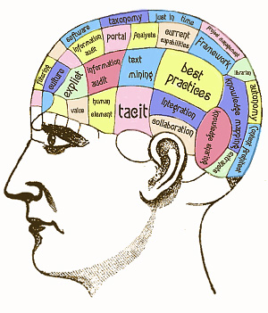
Thank you!
Questions?
A.Kosilov@iaea.org

