Slide 1

Human Resource Solutions to Support NKM
Industry Best Practices
School of Nuclear Knowledge Management
3 - 7 September 2012, Trieste, Italy
Presentation by Ed Boyles

Slide 2
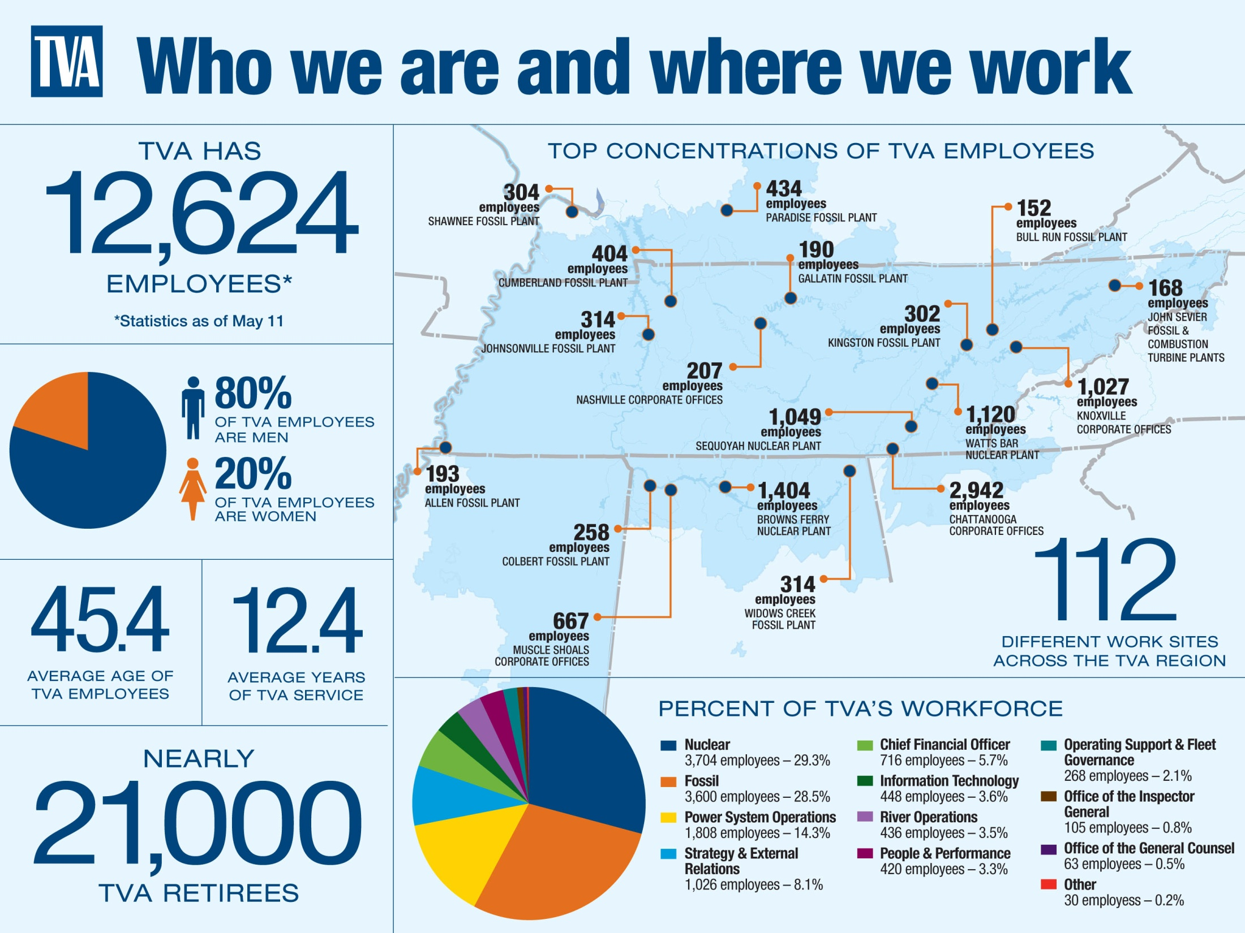

Slide 3
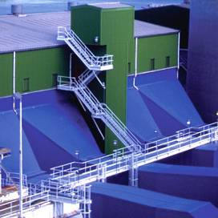
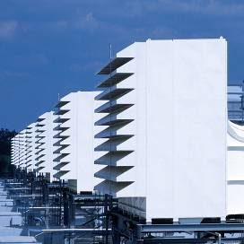

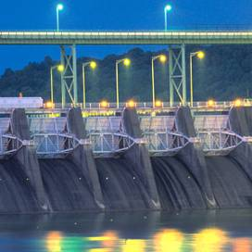
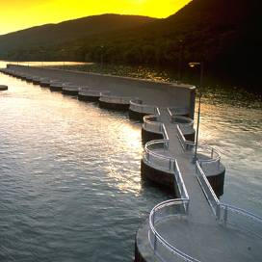

TVA’s Diversified Generation Portfolio
Fossil Plants
Combustion
Turbines
Nuclear
Plants
Hydroelectric
Dams
Pumped-
Storage
Green Power
Generation(Capacity)
Notes:
TVA is in a unique position with nuclear generation development.
We were the first in the 21st century to put new nuclear generation online…and we have other options that will continue to keep us in the front of the pack.
TVA produces electricity from a diversified portfolio of assets:
-29 hydro-electric dams with 109 units and one pumped-storage plant. (9 on main river and 20 on tributaries)
-3 nuclear plants – two in Tennessee and one in Alabama
-11 fossil plants – 59 units.
- 8 combustion turbine installations – including two recently purchased plants – 83 generating units.
FY ‘09 TVA generation: Coal 53%; Nuclear 37%; Hydro 8%; CT and diesels 2%; renewables less than 1%
TVA-owned Capacity – Fossil 45% – Nuclear 21% -- Hydro 15% (including Raccoon) – CTs 19%

Slide 4
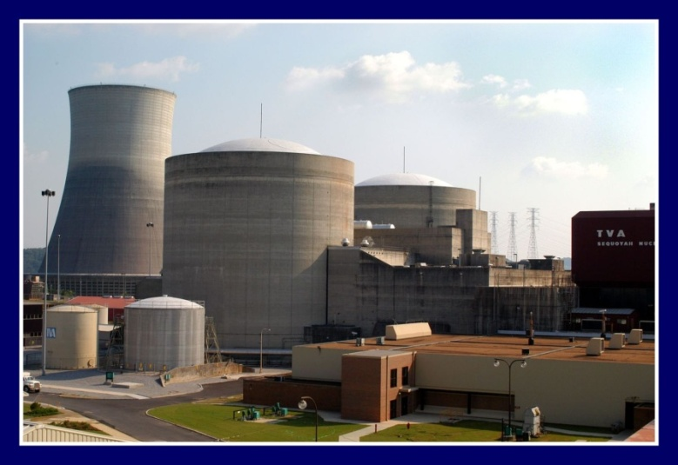
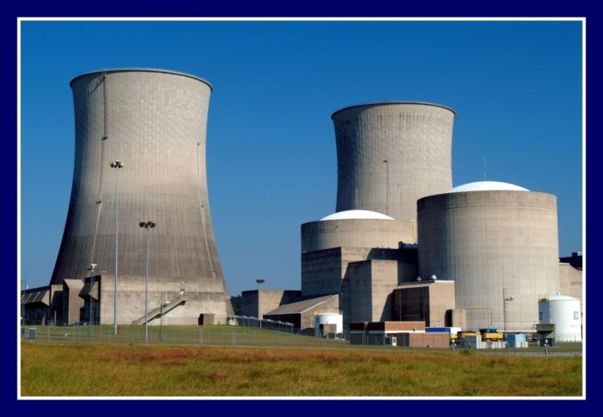
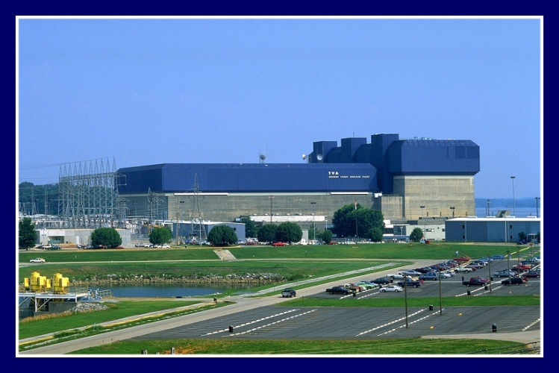

TVA’s Current Nuclear Portfolio
Sequoyah Nuclear Plant
Watts Bar Nuclear Plant
Browns Ferry Nuclear Plant
Notes:
Currently, TVA has 6 operating nuclear units that combined produce a total of 6800 MW of electricity.
-- 2 PWR’s at Sequoyah Nuclear Plant near Soddy Daisy, TN
-- 3 BWR’s at Browns Ferry Nuclear Plant near Athens, AL
-- 1 PWR at Watts Bar Nuclear Plant near Spring City, TN
Since 1998, TVA nuclear plants have achieved annual average production of about 45 million megawatt hours of electricity. Our nuclear portfolio makes up about 30% of our generation. This makes up 79% percent of TVA’s current clean energy portfolio. TVA’s long-term goal is 50% clean energy by 2020.

Slide 5
HR Solutions to Support NKM
  Content
  Strategic Work Force Planning
  Recruiting the next generation
  Training & Development new employees to full competency (Filling the gap)
  Succession Planning – Selecting, evaluating and developing the right people for leadership positions
  Retaining top talent

Slide 6
Strategic Work Force Planning
Planning
Recruiting
Training
Competent
Work Force
Development
Retention

Slide 7
Strategic Work Force Planning
Through out the 1990’s for most utilities - a tactical effort to balance the labor budget and headcount
Little strategic planning occurred
HR Organization (Personnel Services) was not involved attrition management or work force planning strategies
Only recently have more utilities have begun to develop strategic and integrated work force strategies - driven by the loss of experienced staff – primarily through retirements
Notes:
According to a recent Watson Wyatt study one-third of U.S. companies do not have workforce contingency plans in place, according to a recent survey by Watson Wyatt Worldwide. Of those companies that say they have contingency plans in place, more than half say those plans center around layoffs, while an additional 46 percent say their plan is “to restructure their organizations.”
The study findings point to a bigger issue among U.S. companies: Most never do any workforce planning, says Peter Cappelli, director of the Center for Human Resources at the University of Pennsylvania’s Wharton School of Business.
“If they are not planning during bad times, I doubt that they are planning in general about what their workforce needs are going to be in the future,” he says.
As a result, companies constantly will be chasing the problem. When the economy picks up, they are going to be paying a higher premium for talent, experts say.

Slide 8
Development of the WFP System
TVA developed the Integrated Staffing Plan in 1998
Formed a Work Force Planning Group (1999) to implement the strategic planning process - Goals were to:
  Develop long term plans that addressed future staffing demands
  Integrate Work Force Planning with other related processes (Training, Recruiting, etc.)
  Include Staffing Plans in Annual Business Plan
IT tools and reports were developed to support the WFP
The Knowledge Retention Process was a key element of the WFP System
Notes:
TVA faced a significant challenge by 1998 in that one-third of its work force could retire over the next 5 years. This challenge lead to the development of an Integrated Staffing Plan.

Slide 9
Integrated Staffing Plan Model
Work Force Planning is the Key to an integrated Work Force Strategy
Employee Demographics
Attrition Data (Management & Employee Input)
Staffing resource demands
Emerging work
New build plans
Labor Cost
Staffing Benchmarks
Process Improvements
Recruiting
Training
Succession
Planning
Work Force
Planning
Business
Planning
WFP was Key
Knowledge
Retention
Employee
Development
Notes:
The Integrated Staffing Plan provide the overall strategic direction for TVA to address its human resource challenges. The Work Force Plan was the key element that integrated the effort with other related programs (Recruiting, Training, Knowledge Retention, etc.)

Slide 10
WFP Considerations
  Collection and analysis of accurate attrition information
  Current and emerging skills/competency needs
    Improvements in processes
    Improvements in equipment and technology
  Current and future work activities
    Major modifications upcoming
    New build planned
    Decommissioning

Slide 11
WFP Considerations (continued)
Long term staffing plans - 3 to 5 years
  Operations and Maintenance pipeline
  University Recruitment
  Experienced hires (to fill gaps)
  Retention actions for current employees (people and knowledge)
Include staffing plans in the organizations annual Business Plans (budgeted)
Monitor, Measure and Update

Slide 12
Elements of Effective WFP Process
Compile Staffing Demographics
  Forecast Pending Attrition
Develop Staffing Benchmarks
  Compare against best performing plants
  Understand plant specific demands
Develop high level staffing plans
  Budget based
  Confirmed by senior management
Develop detailed staffing plans
  Department level plans
  Identify need by position
Monitor, update and adjust

Slide 13
TVA’s 5 Step WFP Process

Slide 14
Work Force Planning Metrics

Slide 15
The worker Pipeline is Key

Slide 16


A New
Workforce Planning Process
Improving the process

Slide 17
TENNESSEE VALLEY AUTHORITY
WORKFORCE PLANNING PROCESS
The new WFP process will be integrated with TVA’s vision, values, goals and key processes

Slide 18
TVA STRATEGIC WORKFORCE PLAN:
FOUR PHASE PROCESS
Workforce Planning at TVA serves as the foundation for managing our organization’s human capital. It enables us to plan strategically, to meet current and future workforce needs, and prevents unnecessary surprises in maintaining a steady-state workforce. The Workforce Planning Process has been designed to represent four (4) phases. These phases are as follows:

Slide 19
Recruiting the next generation
Planning
Recruiting
Training
Competent
Work Force
Development
Retention

Slide 20


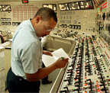


Recruiting Challenges
Recruiting the next generation

Slide 21
Recruiting Challenges
Competition for talent (both entry level and experienced)
Attracting new graduates into technical fields and into nuclear power
Nuclear industry has high degree of qualifications needed - Multiple hurdle selection processes are lengthy
Identifying enough qualified candidates who can successfully pass each hurdle

Slide 22
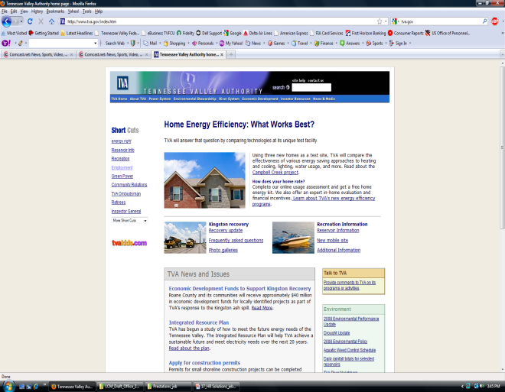
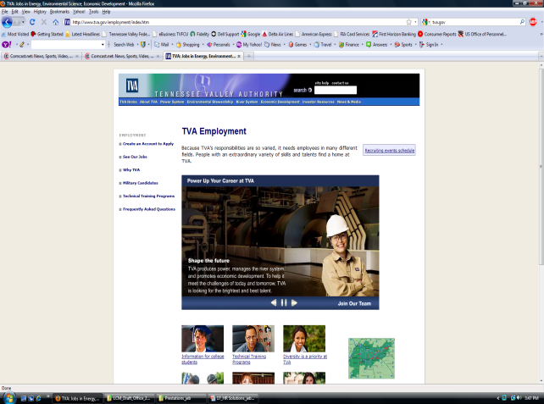
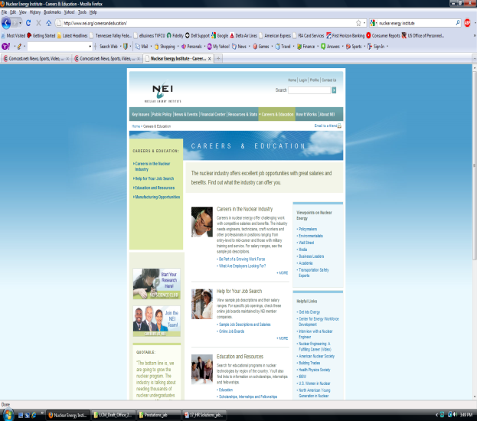
Recruiting Tools
Websites
Energy/specialized websites
Print media (newspapers)
Universities (career fairs)
  Universities and community colleges
Networking at conferences
and meetings
External recruiting firms
Employee referrals
Positive branding of company

Slide 23
Training and Development
Planning
Recruiting
Training
Competent
Work Force
Development
Retention

Slide 24
Engineering Graduate Progression
EGPP

Slide 25
Engineering Graduate Progression
Engineering Levels at TVA (All are Represented by Union)
Engineer Level – A (Entry to 4+ years)
Engineer Level – B (Fully Qualified)
Engineer Level – C (Team Lead)
Engineer Level – D (Technical Specialist)

Slide 26
Engineering Graduate Progression
Designed to address the need to develop TVA graduate engineers to become fully qualified as soon as possible
A combination of training and required work assignments
  Formal Training (Class Room Setting)
  On line (CBT)
  Informal Mentoring
  “On the job” training
  Demonstrated competencies
A clear road map that allows entry level engineers to progress in knowledge, skills, and experience in order to become fully qualified engineers

Slide 27
Engineering Graduate Progression
B Level Engineer
Fully Qualified
Phase III
18 to 24 Months
Advanced Position Specific
Phase II
18 to 24 Months
Position Specific Training
Phase I
12 to 18 Months
Entry Level Orientation

Slide 28
Engineering Graduate Progression
EGPP - Key Elements
Mentors
Technical Experts - Assist the graduate in performing specific technical assignments
Individual Development Plans – IDP - Specific to each entry level engineer and is discipline specific
Engineering Review Board – Approves all reclassification to fully competent level (fully competent) when all training and qualifications are completed

Slide 29
Engineering Graduate Progression
TVA Engineering Graduate Progression Plan (EGPP) Model
Appendix A
Engineer - Level A
Engineer - Level B
Eligible for annual increases and EA Off-Cycle Pay Adjustments
Reclassification to Level B
Phase I (12-18 Months)
Phase II (18-24 Months)
Phase III (18-24 Months)
Approval by Engineering Review Board
TVA ORIENTATION AND INITIAL ENGINEERING ACTIVITIES
e.g. New Employee Experience
STAR 7
Technical Administrative Training:
e.g. Health & Safety
Environmental
Business Processes
Work Management Systems
Technical Fundamentals:
e.g. Systems Training
Developmental Work Assignments
Mentor Assigned
POSITION SPECIFIC- DISCIPLINE ACTIVITIES
e.g. Root Cause Analysis
Regulatory Project Support
System Analysis
Qualification Cards
On-the-Job Training
Developmental Work Assignments
ADVANCED POSITION SPECIFIC QUALIFICATIONS AND DEMONSTRATED PROFICIENCY
e.g. Advanced Regulatory Projects
Systems Analysis
Advanced Qualification Cards
In-depth On-the-Job Training
Developmental Work Assignments
Phase I, II & III Training complete
Qualification Requirements Met
Fully competent engineer by
demonstrated proficiency, (e.g.
Achievement of PE license)
Minimum 4 years of experience
OPA
OPA
RECLASS
PHASE 1
A - LEVEL Entry Rate
80 - 100%
min - max
*PHASE 2
A-LEVEL
95 -110%
min - max
*PHASE 3
A-LEVEL
100 -120%
min - max
*Reclassify to Engineer
B-LEVEL
80-100%
min - max
11/27/02

Slide 30
Selecting and Evaluating Leaders
9 Box Tool
TVA’s program to assess and development top management talent

Slide 31
Selecting and Evaluating Leaders
Key Components
Managers are assessed on Performance and Leadership Potential using “Nine-Box” Model
Regular reviews and discussions occur among executives and senior managers
Strengths and development needs are openly discussed
“Ready Now” and “Ready Long Term” succession candidates are identified for key positions
Greatest investment in developing top talent

Slide 32
9-Box Template
Leadership Potential
1: High Performance/High Potential
3: High Performance/Medium Potential
6: High Performance/Low Potential
2: Medium Performance/High Potential
5: Medium Performance/Medium Potential
8: Medium Performance/Low Potential
Performance
4: New in Position (No longer than 6 mos.)
7: Low Performance/Medium Potential
9: Low Performance/Low Potential

Slide 33
9-Box Template
Leadership Potential
Top Third
1
3
6
Source of Succession
Planning Candidates
2
5
8
Performance
4
New in Position
(No longer than 6 mos.)
7
9
Bottom Third
Notes:
The top third of the 9 Box become our Succession Planning Candidates.
It’s easy to manage top-performing employees but difficult when it comes to improving poorer performers. Some of the greatest opportunities for improved organizational performance lie in helping managers raise the performance of these employees.

Slide 34
Succession Planning
Develops internal replacements for all key leadership and technical expert positions
Values leadership and management capabilities as much as technical knowledge
Actively promotes diversity, especially in leadership ranks
Develops leaders through a variety of means (internal & external training, rotational assignments, special projects, mentoring, etc.)
Develops managers that are effective at identifying & developing talent

Slide 35
Training and Development
Planning
Recruiting
Training
Competent
Work Force
Development
Retention

Slide 36
Retaining Top Talent
In today’s competitive environment companies must take proactive steps to retain key employees:
Positive Branding
Culture and work environment
Provide motivation through challenging assignments and development opportunities
Targeted retention agreements and project incentive programs
Employees fully engaged - Line of sight from their activities to company vision, values, goals
Competitive/market based salary and benefits
Recognize and reward performance
Notes:
Companies that don’t focus on retaining top talent will pay premium prices to replace its losses.

Slide 37
Goal = Maintain Competent Workforce
Planning
Recruiting
Competent
Workforce!
Training
Development
Retention

Slide 38
Thanks!
Questions?

Slide 39
Expectations: 9-Box Model
The 9-Box model involves rating the Performance and Leadership Potential
Initial ratings should be made by the immediate - should be discussed and revised, as necessary, as they are rolled-up the organization.
Individuals in Box 4 (New in Position) 3-6 months
Focus is given to development of top third individuals and performance improvement planning with low performers.
Managers should provide all employees with feedback on performance and potential.
Development Plans and Performance Improvement Plans should be developed and tracked

Slide 40
9-Box Performance Definitions
High Performance “Exceptional Performer”
  Exceeds most goals – especially those of high priority.
  Clearly delivers results to lead TVA in outperforming the competition.
  Consistently performs at the highest level.
  Is fully committed to and “lives” all of TVA’s competencies. Leads by example, and is consistently regarded by peers and supervisors as a role model in all areas of behaviors.
  Always seeks to incorporate ideas and views of others. Is sought out by others to provide advice, to lead teams, and to champion change. Sets an example for everyone in executing strategies.
  Always takes opportunity to be accountable. Highly adaptable to new skills, behaviors, and information. Clearly understands unit’s strategy and actively contributes to reshaping agenda.
  Develops and leads direct reports to achieve results. Creates and communicates a compelling vision and a strategy for meeting the vision.
Medium Performance “Significant Contributor”
  Achieves all goals, at a minimum, and may even exceed some.
  Delivers results to help TVA outperform the competition.
  Takes on extra projects and/or tasks without defaulting on basic objectives and responsibilities.
  Abides by the TVA competencies and is effective, but has room to improve behavior. Sets a uniformly good behavioral example for others. Understands other’s views and ideas.
  Provides sound advice. Leads team with collaborative and committed spirit. Constructively challenges teams.
  Comfortable and responsive in new situations and when faced with new information. Demonstrates clear understanding of, and can be relied on to execute, strategies. Is committed to TVA’s strategy and proactively seeks advice when needed.
  Proactively seeks feedback and acts upon it to improve capabilities and performance.
  Manages direct reports to achieve results. Is effective in communicating expectations to team members.
Low Performance “Does Not Meet Expectations”
  Does not achieve expected results; does not achieve high-priority goals, or does not achieve over half of total goals.
  Consistently ignores or conflicts with one or more of the TVA competencies. Behaviors need focused attention.
  Does not consistently demonstrate understanding of other’s views and ideas, contribute to teams, work well in ambiguous situations, and/or understand TVA’s strategies.
  Usually needs significant guidance to achieve results.
  Does not focus on developing direct reports. Lacks ability to effectively communicate vision and strategy.

Slide 41
9-Box Leadership Potential Definitions
High Leadership Potential
    Strong learning agility, i.e., curious, open to learning and able to learn quickly from experience.
    Thinks conceptually, strategically and maintains a broad perspective
    Exhibits a strong internal drive to have impact on the business and see results; shows a bias toward focused action
    Exerts positive, wide spread influence across the organization; communicates in an articulate manner, treats others with appreciation, respect and dignity
    Adapts easily to new, ambiguous or changing conditions; maintains realistic optimism and effectively leads change
    Holds self and others to high expectations; is a model for personal accountability, and is effective in driving accountability in others
    A role model for honesty and integrity, with a capacity for personal humility
    Interested in and capable of moving up one level immediately and another level in the near future. Could move within or across business units
    Limitations can be addressed by experience and/or targeted development
Medium Leadership Potential
    Moderate learning agility and adaptability to new or changing conditions; able to make decisions in ambiguous situations
    Demonstrates some knowledge of the big picture, but may have difficulty in maintaining a broad perspective
    Demonstrates many of the leadership competencies beyond current role and responsibility, however, some limitations in leadership style and approach need to be addressed
    Has potential to take on greater roles within the company. Could move up one level within the business unit in the short-term future or assume significantly greater responsibilities within current level.
Low Leadership Potential
    Not an agile learner; does not always learn from mistakes and has tendency to make errors.
    Clearly indicates significant limitations in leadership abilities
    Has difficulty with new or changing conditions; unable to make quality decisions in ambiguous situations
    Does not exert positive, widespread influence across the organization
    Does not manage through others to drive accountability through the organization
    Cannot maintain a broad perspective; operates from a more narrow, tactical or functional view versus broad and strategic
    May not be capable of progressing to the next level or to take on greater roles within the company; retention contingent on performance and unique expertise/value
    May be a blocker or inappropriately placed

Slide 42
Development Guidelines
Leadership Potential
1: High Performance / High Potential
3: High Performance / Medium Potential
6: High Performance / Low Potential
Ready for promotion or significant rotational assignment.
Special assignments across organizational lines.
Provide opportunities for visibility with Sr. Leaders.
Business education (MBA, certificates, etc.) and/or assignments.
Provide mentoring and/or have employee serve as mentor.
Clarify employee career goals.
Develop replacement(s) for current position
Special assignments or projects to develop leadership skills and increase visibility.
Business education (MBA, certificates, etc.) and/or assignments.
Lateral moves or rotational assignments.
Provide mentoring.
Clarify employee career goals.
Develop replacement(s) for current position
Continued development of technical expertise.
Self-directed learning (reading, on-line training, etc.)
Coach others in technical areas. Transfer critical knowledge.
If in leadership role and/or is a “blocker”
Ensure expectations are clear and opportunities to show leadership exist.
Move to specialist/ technical role.
2: Medium Performance / High Potential
5: Medium Performance / Medium Potential
8: Medium Performance / Low Potential
May be ready for promotion or significantly increased responsibilities.
Business education (MBA, certificates, etc.) and/or assignments.
Lateral moves or rotational assignments.
Provide mentoring.
Clarify employee career goals.
Develop replacement(s) for current position
Role-specific development (Eng. Progression Plan, Supervisor Academy, etc.).
Rotational assignments using current skill set with different issues.
Begin to focus more on business and leadership skills and less on technical skills.
Provide opportunities to work with other groups.
Keep technical skills current
Self-directed learning (reading, on-line training, etc.)
If in leadership role and/or is a “blocker”
Ensure expectations are clear and opportunities to show leadership exist.
Move to specialist/ technical role.
Performance
4: New in Position (No longer than 6 mos.)
7: Low Performance / Medium Potential
9: Low Performance / Low Potential
Ensure expectations are clear and resources available.
Provide coaching and visibility.
Provide employee opportunities to perform
Reassess.
Ensure expectations are clear, resources available, and job-specific training and coaching have been provided.
Begin Progressive Discipline process.
Prepare for move to a different role.
Ensure expectations are clear, resources available, and job-specific training and coaching have been provided..
Begin Progressive Discipline process.
Prepare for move to a different role or to leave TVA.

