Slide 1

Knowledge Capture & Sharing
People to People
School of Nuclear Knowledge Management
Trieste, Italy
ICTP and IAEA
3 – 7 September 2012
By Ed Boyles
jeboyles@epbfi.com

Slide 2
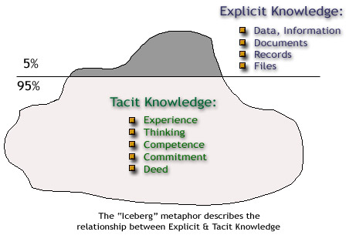
The knowledge Iceberg
Notes:
Compare explicit and tacit knowledge using the Knowledge Iceberg. Note that the 5% and 95% may not be true for the nuclear industry. The nuclear industry does some things that support Knowledge Management:
Corrective Action Programs
Operating Experience
Configuration Control
The chart emphasized the importance and magnitude of tacit knowledge

Slide 3
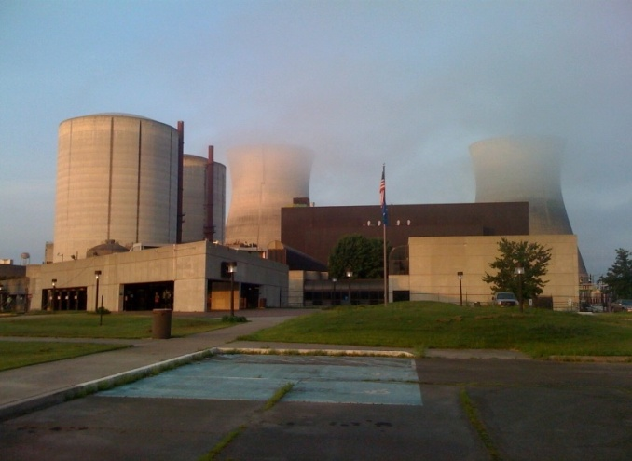
Why is it important?
An aging nuclear workforce
A growing need for clear energy.
The expanding role of nuclear power.
Nuclear Energy Institute
officials have continued to say
that the most that anyone
could reasonably expect
would be four to eight new
reactors entering service in
the 2018 time frame.
Notes:
Discuss the world’s need for clear energy and the expanding role of nuclear power
Any expansion will require knowledgeable and skilled workers
It takes several years to prepare these workers (education, training and experience

Slide 4
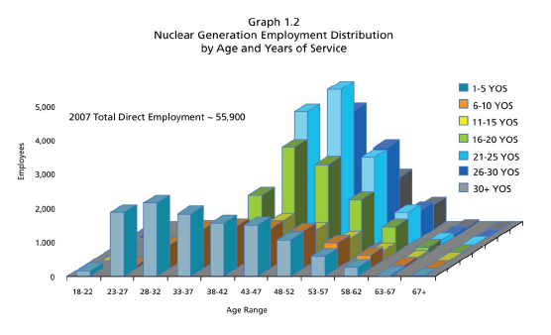
Why is it important?
Workforce Aging – Experience Loss
We have a knowledge and experience bubble
Notes:
Discuss the aging workforce challenge within the nuclear industry.
Period of stagnation in the 1980s and 90s
Impact of Three Mile Island and Chernobyl and other factors (cost, regulatory, public support)
A lost generation of nuclear workers resulted
By the late 1990s the average age was about 46 years
The impact of the loss of these experienced workers is a threat to safe and efficient operations of current NPPs and future expansion
Reference the NEI graph: Nuclear Generation Employment Distribution by Age and Years of Services

Slide 5
Approaches
To
Knowledge
Capture & Sharing

Slide 6

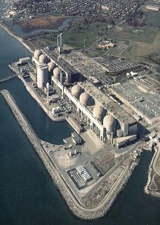
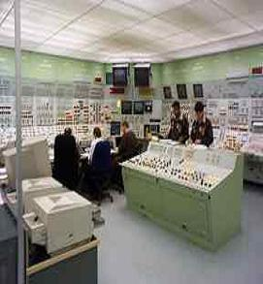
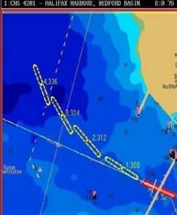
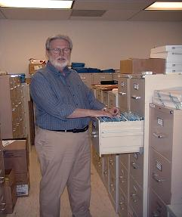
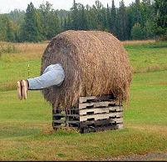

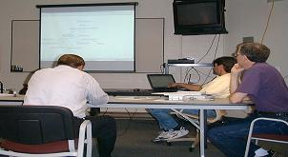


Approach may depend on type
Identify types of knowledge to be elicited from each expert
Historical
Job/task performance
Predictions
Information sources
Thought Process
Expert Novice
Select approach to knowledge elicitation and capture
Elicitor interacts with expert
Self-elicitation and capture
Advanced knowledge capture
Community of practice
Notes:
The way(s) knowledge is transferred may depend on the type of knowledge, for example, the thought process of subject matter experts may require more advanced techniques that knowledge of historical events.
Historical knowledge – Self-elicitation
Problems solving/thought processes – Trained elicitator, Concept Maps, etc.

Slide 7

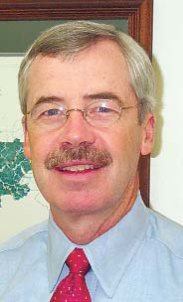
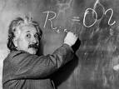
Approaches
Our focus:
Practical ways to transfer, exchange and share knowledge among people
"Wisdom is not a product of schooling but of the lifelong attempt to acquire it."
Albert Einstein
Competency = Knowledge + Skill + Attitude
Because people are the repositories of Knowledge
Notes:
In the 1990's when many companies were beginning Knowledge Management (KM) programs, often the emphasis was on information technology solutions with efforts aimed at development of big brain (data base) systems to store all knowledge important to the enterprise.
The nuclear industry was in the mist of two decades of stagnation and focusing on downsizing staffs to achieve cost saving in order to compete with other fuel sources. Very little strategic HR planning or KM activities occurred during this period.
By the end of the 90's some nuclear organizations began to recognize the next challenge - the aging workforce and the associated loss of experienced workers. These workers had literarily designed, built, and operated the nuclear fleets for over thirty years. Now the industry faced not only the loss of workers but the loss of critical knowledge and skills they possessed. As the industry looked for answers they developed a different approach to KM - a focus on the human resource asset.
Our focus is on practical ways to transfer, exchange and share knowledge (especially tacit).

Slide 8
Approaches
Determine which knowledge is worth sharing?
    It is a question of…. What? So What? Now What?
    What….is the specific knowledge?
    So what….are the consequences of loss?
    Now what….do we do about it?
    Critical Knowledge: Knowledge that is important to the organization is covered in “Risk Management of Knowledge Loss” presentation
Notes:
Is all knowledge equal? When considering what knowledge should be transferred, the questions of:
What is the specific knowledge
What are the consequences of loss and
What do we do to capture, transfer, share
Knowledge that is important to the mission of the organization is considered “Critical Knowledge”
Definition of Critical Knowledge – Mission critical knowledge and skills, unique, no backup or ready replacement and takes several years to develop.

Slide 9
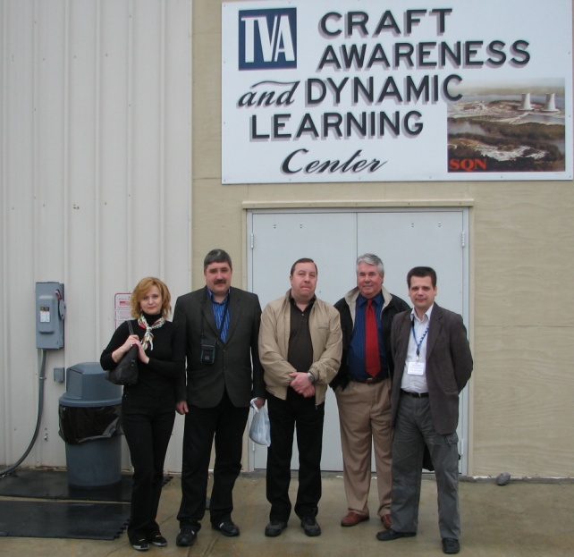
Mockups: Dynamic Learning
Notes:
One effective approach to transfer knowledge is the use of mockups or models. The picture is of visitors to the Sequoyah NPP Craft Awareness and Dynamic Learning Center.

Slide 10
Dynamic Learning
INPO Accredited Training Programs
Utilize classroom, computer based and on-the-job training
Trainers are experienced engineers, operators and senior craft (electrician, mechanical, instrumentation and controls, etc.)
Also use retirees to supplement training
Notes:
The learning center is used for training skilled craft trainees many who have never entered an NPP.

Slide 11
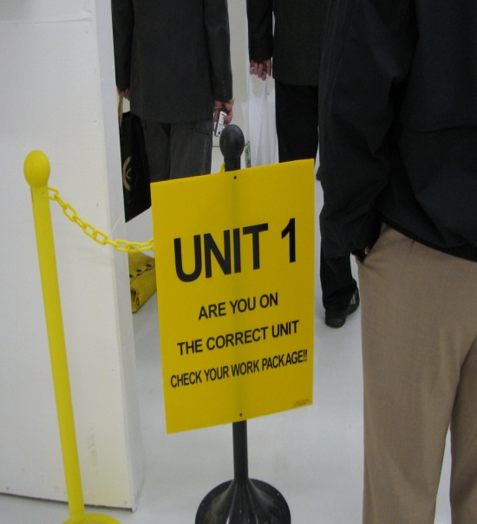
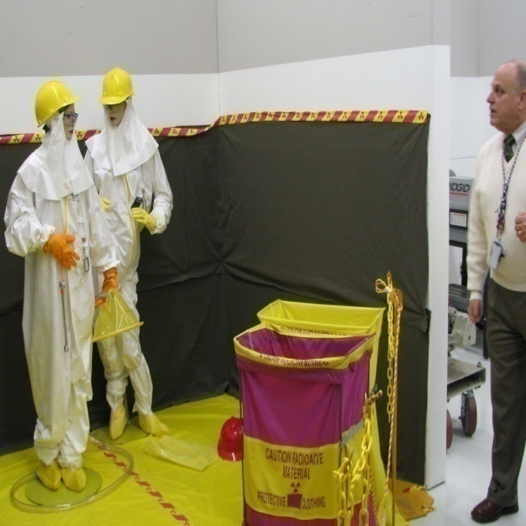
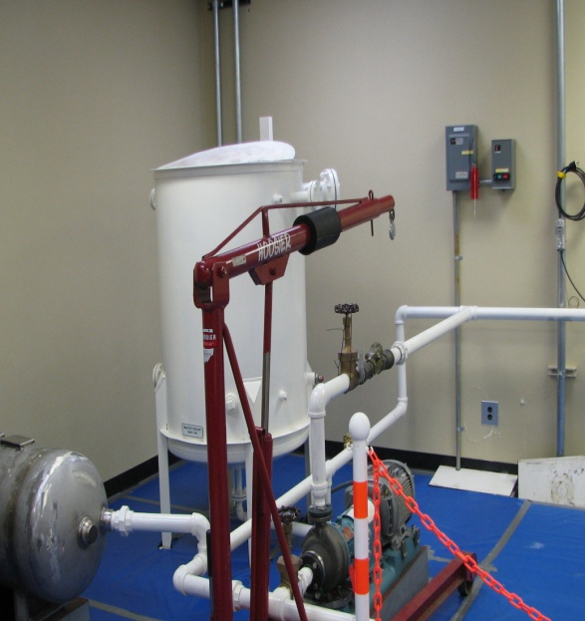
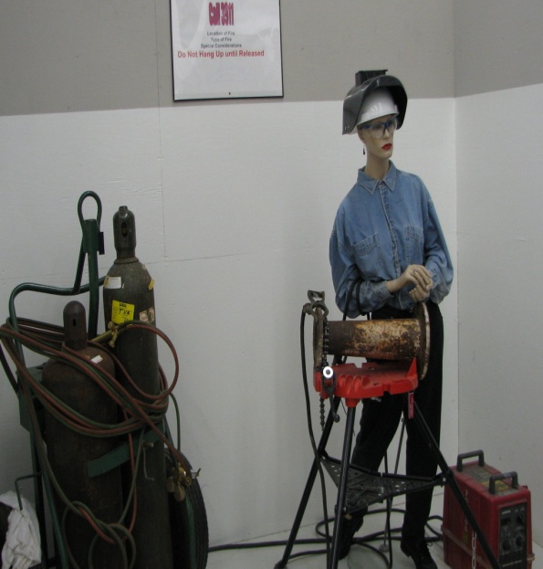
Dynamic Learning
Dynamic Learning Center – Class Room Training combined with a virtual plant environment
Notes:
Discuss the training program: Combination of class room and a virtual plant environment. After class room training, small groups of trainees are taken through the virtual plant by experienced staff. They are asked to make observations and identify problems or violations of rules and procedures.

Slide 12
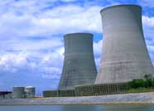
Dynamic Learning
You can’t share knowledge without a pipeline of new workers
Typical Two Unit Schedule for U.S. Utility
COL Application to Unit on line
COL Application
Submitted
To
NRC
COL Issued by NRC
Utility prepares for Const. activities
Start of
Construction
Activities
1st concrete to fuel load
Fuel Load
Begin pre-op
testing
On-line operation
of Unit
NRC COL and Environmental
Review (3 to 3.5 Years)
Utility preparatory activities
timeline
4 to 8
Months
5 to 6 Years
6 to 8 Months
Time-line estimate indicates approximately 10 years from COL application to on-line operation
Combined Construction and Operating License (COL)
Notes:
Discuss the length of time (license application to operations) required to bring an NPP online and the importance of early planning to ensure qualified workers are available.

Slide 13

Peer Teams
Notes:
Peer Teams: Next approach to transferring knowledge.

Slide 14
      Peer Teams
Peer teams are usually internal groups (similar to CoPs) formed to share knowledge and experience
Peer teams are often utilized in nuclear fleets (several NPP’s)
Peer Team Examples: Maintenance, Operations, Engineering, Training, Human Resources, Supply Chain, Industrial Safety, etc.
Members represent individual plants or organizations
    Meet periodically (e.g., monthly)
    Share knowledge and experience from NPP’s
    Focus on improving plant performance through:
      Standardization of processes and procedures
      Initiating process improvement teams
      Sharing resources (e.g., outage support)
      Sharing expert knowledge (sometimes a limited resource)
Peer Team Meeting
Notes:
Peer teams are usually internal to company and are formed to standardize process, procedures, and to share knowledge and resources
Often utilized in fleet (multiple NPPs)
An example of a Peer Team would be – Maintenance Peer Team
Members represent individual NPPs
Share knowledge from their plant
Focus on plant improvements, efficient operations

Slide 15
Peer Team Governance
Team Charter - outline objective, process and rules
Members are typically senor managers (e.g., Maintenance Manager Operations Manager, etc.)
Peer Team chair is normally rotated among members
Meeting schedules and agendas are set and published
Records are maintained of each meeting
Cross organizational teams (NPP A, B, C and D) are utilized to conduct studies, investigate events, and advise the Peer Team
Other Peer Teams may be invited to participate in initiatives when other skills are needed (e.g., HR to attend Maintenance Peer team meeting to address knowledge management or staffing issues)
Teams report periodically (on a rotating basis to Executive Management)
Notes:
Discuss above governance (rules )

Slide 16

Communities of Practice (CoP)
Notes:
Next approach is Communities of Practice

Slide 17
Communities of Practice (CoP)
Nuclear Human Resource Group (NHRG) is a Nuclear Energy Institute (NEI) Community of Practice
Objectives - ”Provide a forum for nuclear Human Resource practitioners to exchange information on Human Resource management issues that uniquely affect Nuclear Power Operations”
Also to:
  Provide HR information…timely & cost effective
  Provide HR tools…metrics, reports, workshops
  Continue HR Professionalism in our industry
  Identify Methods & Standards…to control HR costs
  Continue to show value
Notes:
Communities of practice
The basic argument made by Jean Lave and Etienne Wenger is that communities of practice are everywhere and that we are generally involved in a number of them - whether that is at work, school, home, or in our civic and leisure interests. Etienne Wenger was later to write:
Communities of practice are formed by people who engage in a process of collective learning in a shared domain of human endeavor: a tribe learning to survive, a band of artists seeking new forms of expression, a group of engineers working on similar problems, a clique of pupils defining their identity in the school, a network of surgeons exploring novel techniques, a gathering of first-time managers helping each other cope. In a nutshell: Communities of practice are groups of people who share a concern or a passion for something they do and learn how to do it better as they interact regularly. (Wenger circa 2007)
Professional communities formed around specific skill-sets (i.e. composite material engineering) or job descriptions (policy analyst) are the core of the community of practice approach. By linking people together based on professional domain, organizations can break down silos created by functional areas or projects, and generally build overall capacity in those skill areas.
The characteristics of communities of practice
According to Etienne Wenger (c 2007), three elements are crucial in distinguishing a community of practice from other groups and communities:
The domain. A community of practice is something more than a club of friends or a network of connections between people. 'It has an identity defined by a shared domain of interest. Membership therefore implies a commitment to the domain, and therefore a shared competence that distinguishes members from other people' (op. cit.).
The community. 'In pursuing their interest in their domain, members engage in joint activities and discussions, help each other, and share information. They build relationships that enable them to learn from each other' (op. cit.).
The practice. 'Members of a community of practice are practitioners. They develop a shared repertoire of resources: experiences, stories, tools, ways of addressing recurring problems—in short a shared practice. This takes time and sustained interaction' (op. cit.).

Slide 18
NEI CoP’s
CONFIGURATION MANAGEMENT
EQUIPMENT RELIABILITY WORKING GROUP
NUCLEAR SUPPLY CHAIN STRATEGIC LEADERSHIP
NUCLEAR INFORMATION TECHNOLOGY STRATEGIC LEADERS
NUCLEAR ASSET MANAGEMENT
NUCLEAR INFORMATION MANAGEMENT STRATEGIC LEADERS
NUCLEAR HUMAN RESOURCES GROUP (SS004)
LICENSING COMMUNITY
FIRE PROTECTION
WORK MANAGEMENT WORKING GROUP
HR practitioners to exchange information on HR management issues that uniquely affect Nuclear Power Operations”
Notes:
Cover the 10 NEI CoPs with emphasis on Nuclear Human Resource. The ten are based on the NEI Standard Nuclear Performance Model.

Slide 20
Benefits of the CoP
  The Major Benefit is in the sharing of the knowledge and experience of the US nuclear HR community to improve overall performance
Examples of Specific benefits
NHRG Annual Benchmarking Conference
Contact List and Surveys: all companies and contacts listed with name, email and phone numbers
Nuclear Labor Relations: benchmark labor issues & all bargaining unit agreements posted on our web pages.
Nuclear Compensation: annual meetings including an every other year job matching initiative supported by a consulting firm
Nuclear HR and Electric Utility Group Web Pages: all conference presentations, surveys and bargaining unit agreements posted on web (restricted access)
Notes:
The main benefit is the sharing of knowledge and experience with the US nuclear HR community

Slide 21
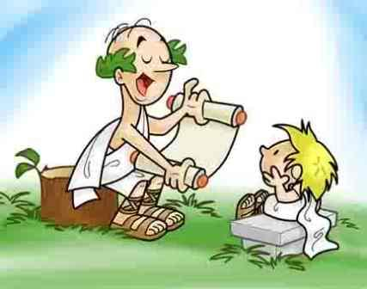
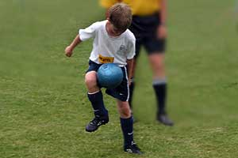
Mentoring and Coaching
Notes:
Mentorship refers to a personal developmental relationship in which a more experienced or more knowledgeable person helps a less experienced or less knowledgeable person. The receiver of mentorship was traditionally referred to as a protégé, or apprentice but with the institutionalization of mentoring the more neutral word "mentee" was invented and is widely used today.
There are several definitions of mentoring in the literature. Foremost, mentoring involves communication and is relationship based. In the organizational setting, mentoring can take many forms. One definition of the many that has been proposed, is "Mentoring is a process for the informal transmission of knowledge, social capital, and the psychosocial support perceived by the recipient as relevant to work, career, or professional development;mentoring entails informal communication, usually face-to-face and during a sustained period of time, between a person who is perceived to have greater relevant knowledge, wisdom, or experience (the mentor) and a person who is perceived to have less (the protégé)" (Bozeman, Feeney, 2007).

Slide 22
Mentoring and Coaching
Person to person is an effective way to transfer knowledge (especially tacit) to a newcomer
Select the mentor/coach carefully – not all experts are good at this (mentor training is helpful)
Make sure the mentor and learner are a good match
Use more that one technical expert where appropriate
Allow adequate time (strategic workforce planning is important)
Monitor progress
Don’t underestimate the newcomers – knowledge sharing may go both ways
Notes:
Discuss slide

Slide 23
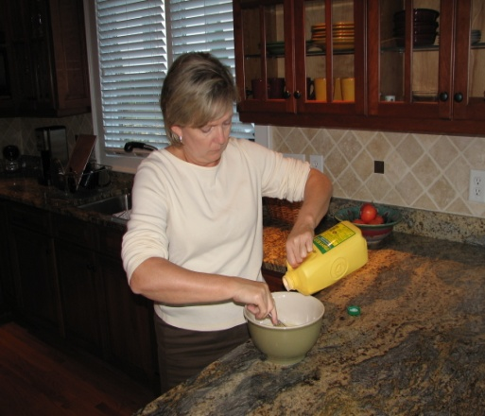
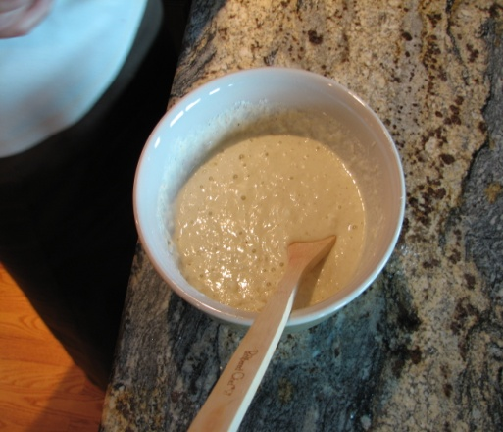
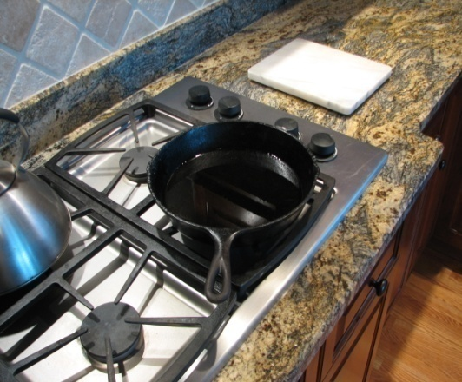
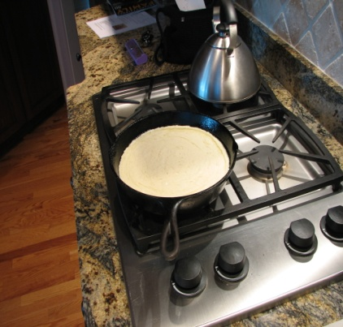

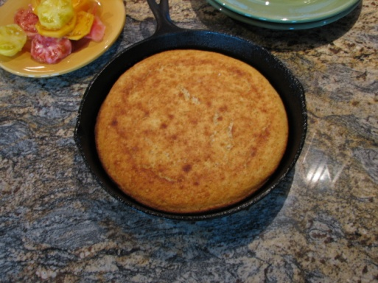
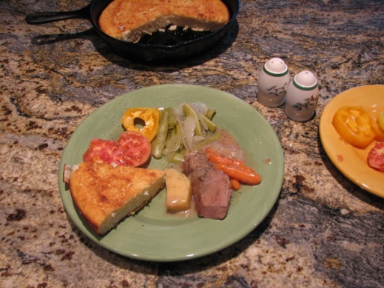
Mentoring and Coaching
Explicit vs. Tacit Example
Explicit
Knowledge
Tacit Knowledge needed
Explicit
Knowledge
Tacit Knowledge needed
Positive Results
Cornbread – A southern US delicacy: I have the recipe but can’t achieve the same results. Making cornbread looks easy but I’m missing some tacit knowledge.
Notes:
Another approach to transferring and sharing knowledge. A simple example of how to prepare cornbread. Lots of tacit knowledge to be transferred. The explicit knowledge comes in the form of the receipt (that’s our work plan or procedure).
But when a novice tries to follow the receipt the level of tacit vs. explicit become evident.

Slide 24
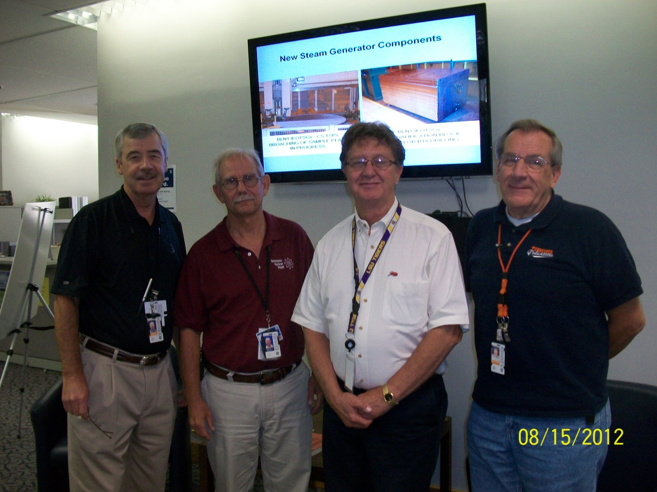
Mentoring and Coaching at Bellefonte NPP
?
SME PRA and Safety Analysis
SME
Engineering Support
SME Metallurgy and SG

Slide 25
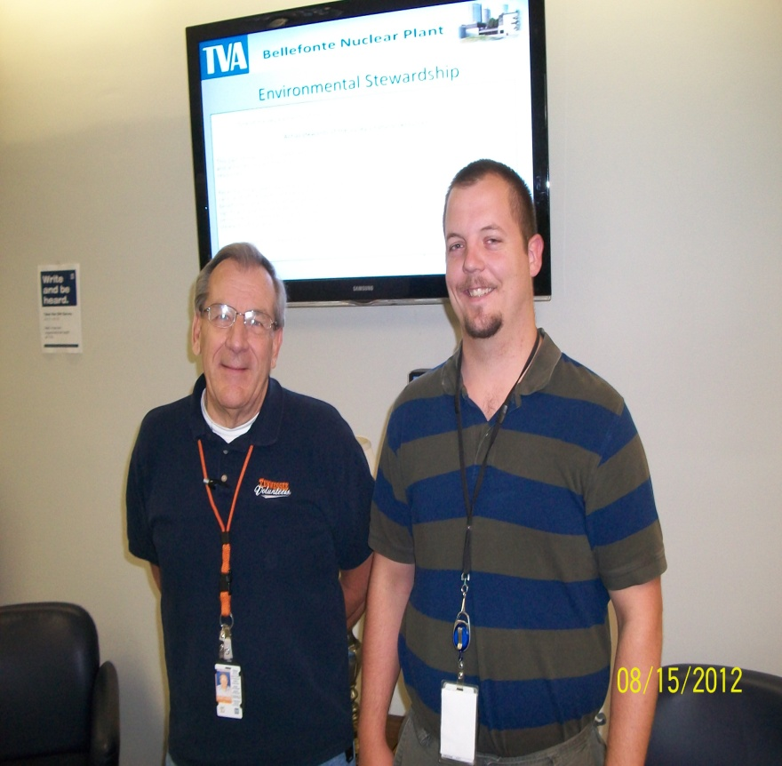
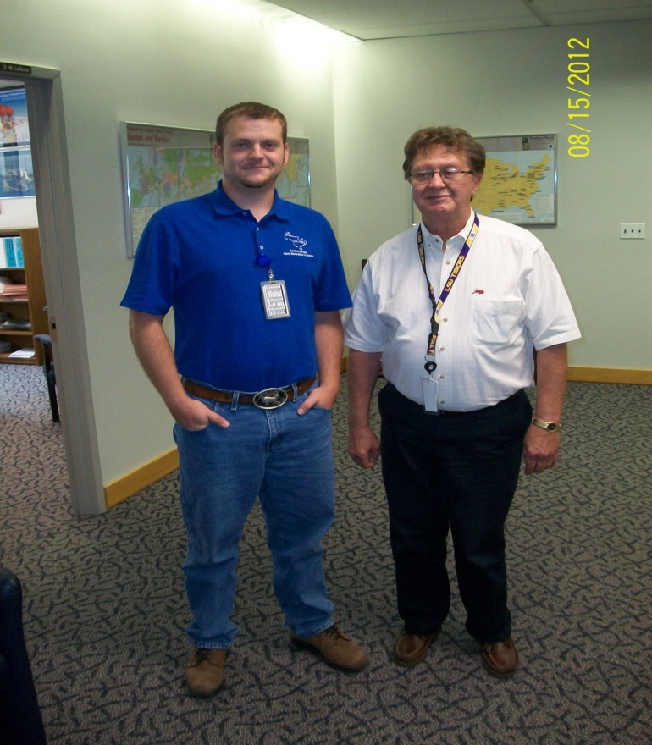
Mentoring and Coaching
One to One
Young engineers are assigned a mentor as part of progression plan
PRA/Safety Analysis
Steam Generator Replacement

Slide 26

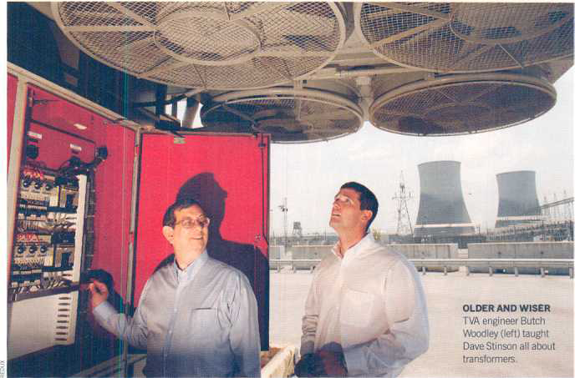
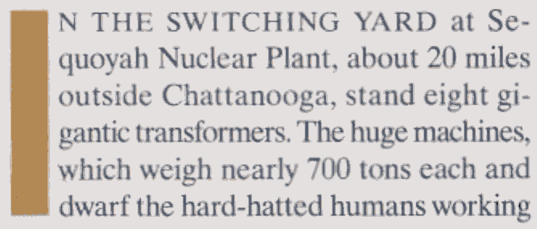
Mentoring and Coaching
When workers retire, they take critical know-how out the door. But one government agency found a better way to pass it on. BY ANN FEISHER
FORTUNE July 24, 2006
A example of knowledge
Mentoring/Coaching
Maintenance of eight step-up 160,000 volt transformers
More on the process in the presentation on Risk Management of Knowledge Loss
Notes:
This is a real example of mentoring and coaching.

Slide 27
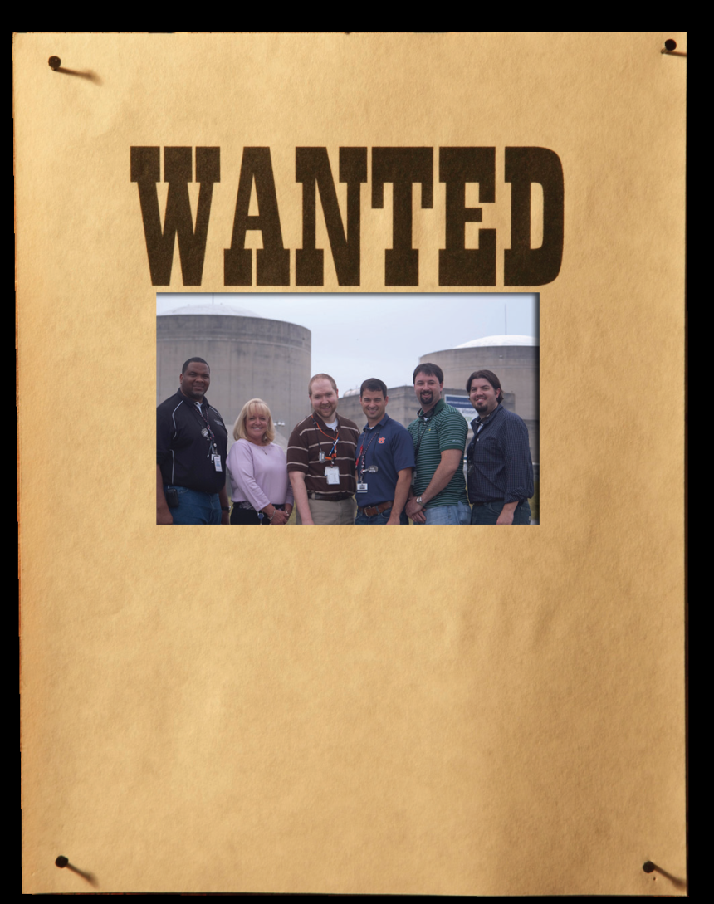
Employee Advisory Group
Nuclear Construction’s Employee Advisory Group
Watts Bar Nuclear Plant
If you see these people, let them
know what your ideas are for a better
workplace!
Nuclear Construction’s Employee
Advisory Group is here to help you!
Contact one of the above members
if you have ideas, concerns or just
want to know what is going on within
Nuclear Construction.

Slide 28
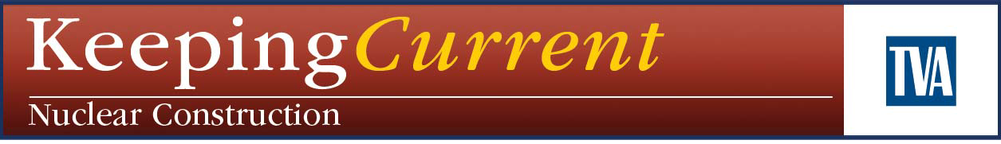
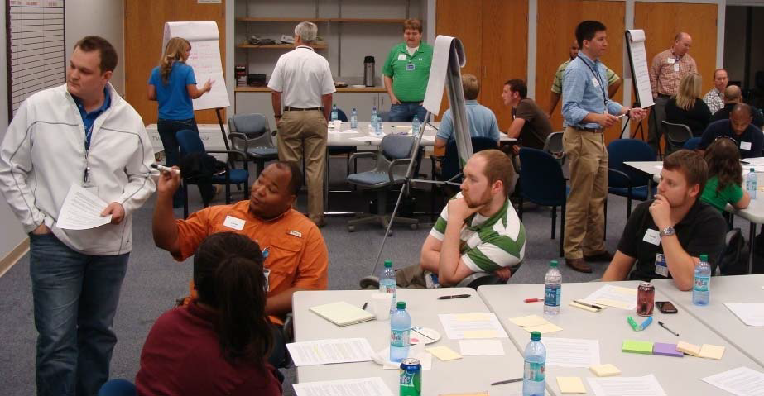
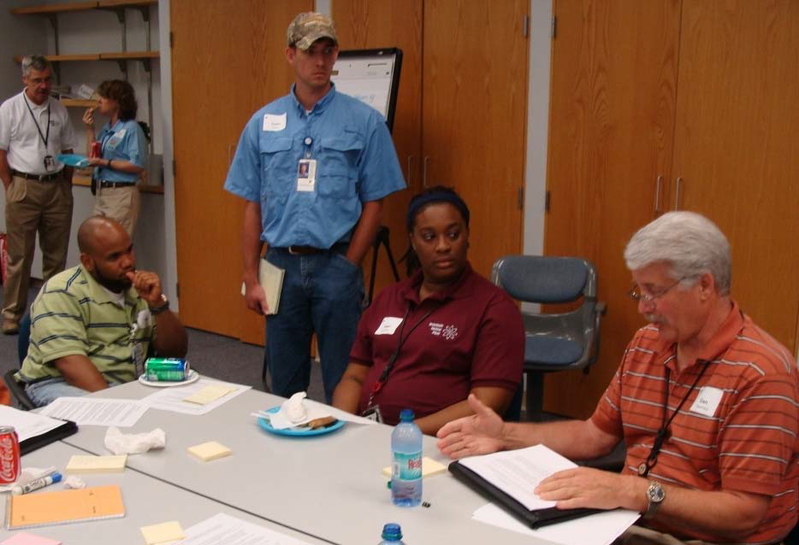
Engineering Forum
June 12, 2012
Young Engineers in Nuclear Construction
More than 30 engineers from the Bellefonte Unit 1 and Watts Bar 2 projects:
Career Development
Lessons Learned
Knowledge Transfer
Event sponsored by the Employee Advisory Group

Slide 29
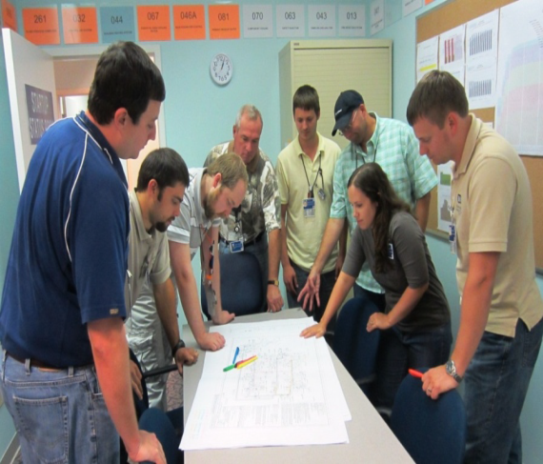
Lunch and Learn
Bring your lunch and learn/share
Mentors and Coaches share with a group
Recent Topics include:
Brown Ferry fire 1975 (History + Appendix R)
Safety Analysis
FSAR
From Design to Construction
Bulk-System Turn Over
Work Order Flow Process
EDCR Closure (Design Change Document)

Slide 30
Summary
Tacit (undocumented) knowledge is often the most important and also the most difficult knowledge to capture and transfer
There is more than one approach – we’ve covered some examples – others will be discussed this week
People to people sharing is an effective way to share tacit knowledge
Notes:
Cover summary and emphasize importance of tacit knowledge as well as challenge.
Define siloed organizations.
A siloed organization or department operates in its own environment, does not consider the company as a whole – They are just not interested in the other parts of the organization - as long as they look good, meet goals all is well.
A siloed organization does not share knowledge but often hordes. To them knowledge is power.

Slide 31

Thanks!
Questions?

